Slide 1
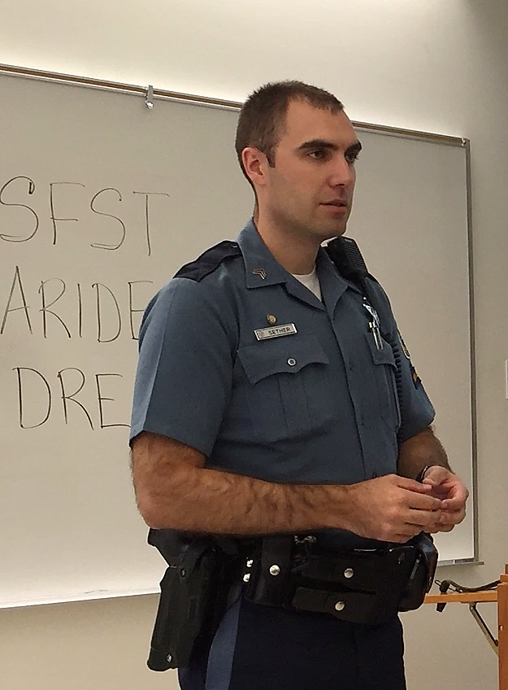



Session 1
Introduction and Overview
“Drugs and Highway Safety”

Slide 2
Learning Objectives
Explain goals and objectives of training
Identify elements of drug problem
Define and describe impaired driving enforcement programs
Understand roles and responsibilities of DRE and how training supports DEC Program
Define term drug in context of traffic safety and impaired driving enforcement as referenced in DEC Program

Slide 3

Welcome to the Advanced Roadside Impaired Driving Enforcement (ARIDE) Training !

Slide 4

Housekeeping
Paperwork
Mandatory attendance
Breaks
Facility
Interruptions

Slide 5

Participant Introductions
Name
Agency affiliation
Experience

Slide 6


ARIDE Pre-Training Exam

Slide 7

Play Impaired Driving Impact Video of your choosing (Optional)

Slide 8
Training Goal
Train law enforcement officers to observe, identify, and articulate signs of impairment related to drugs, alcohol, or a combination of both, in order to reduce the number of impaired driving incidents, serious injury, and fatal crashes.

Slide 9
Training Objectives
Properly administer and articulate SFSTs
Describe relationship of drugs to impaired driving incidents
Observe, identify, and articulate observable signs of drug impairment

Slide 10
Training Objectives
Identify, document, and describe indicators observed and information obtained related to impairment which leads to arrest/release decision
Articulate, through testimony, impairment related to alcohol, drugs, or a combination of both based on a complete investigation

Slide 11
Training Sessions
Introduction and Overview “Drugs and Highway Safety”
Standardized Field Sobriety Testing Review
Standardized Field Sobriety Testing Proficiency Examination
Drugs in the Human Body
Observation of the Eyes and Additional Tests for Drug Impairment
Seven Drug Categories
The Effects of Drug Combinations
Pre and Post Arrest Procedures
Written Examination and Program Conclusion

Slide 12
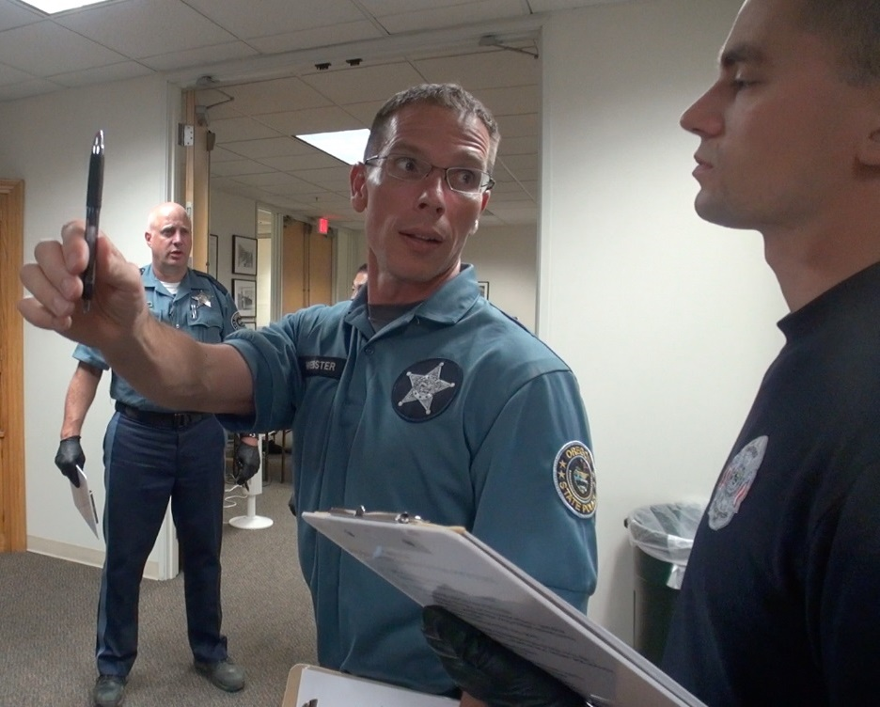
ARIDE Prerequisites
SFSTs review and update
Pass SFST proficiency evaluation

Slide 13

Important Note
This training is not intended to be a substitute for the DEC Program
This training will NOT qualify or certify the participant as a DRE
ARIDE is a training and NOT a certification

Slide 14

Background: High Visibility Enforcement Efforts

Slide 15
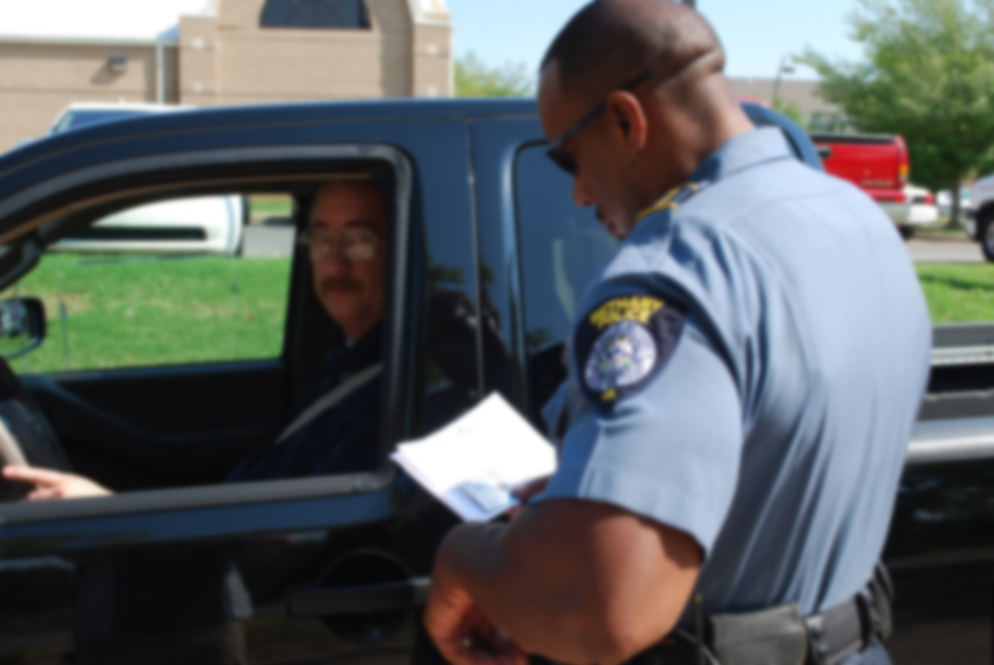
What happens when an officer comes in contact with a drug-impaired driver?

Slide 16
What is a “Drug”?
“Any substance that, when taken into the human body, can impair the ability of the person to operate a vehicle safely.”

Slide 17
2020 National Survey Drug Use and Health (NSDUH)
Slightly less than half of Americans consider themselves drinkers
6.4% describe themselves as heavy drinkers
37.3 million people used illicit drugs in the past month

Slide 18
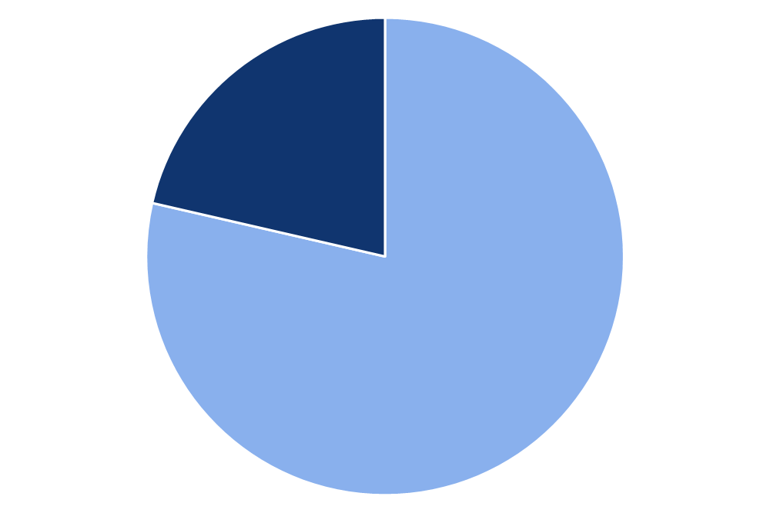
Alcohol and Drug Use
Marijuana
49.6M
Rx Pain Reliever Misuse
9.3M
No Past Year
Illicit Drug Use
Hallucinogens
7.1M
Past Year
Illicit Drug Use
59.3M People
(21.4%)
Rx Tranquilizer or Sedative Misuse
6.2M
Cocaine
5.2M
Rx Stimulant Misuse
5.1M
Methamphetamine
2.5M
217.6M People
(78.6%)
Inhalants
2.4M
Heroin
902,000
0 10 20 30 40 50 60
Number of Past Year Users

Slide 19
Driving Under the Influence
Males are twice as likely as females to drive under the influence of alcohol
8.2% reported they had driven at least once in the last year under the influence of alcohol
11.8 million people reported they drove under the influence of illicit drugs during the last year

Slide 20
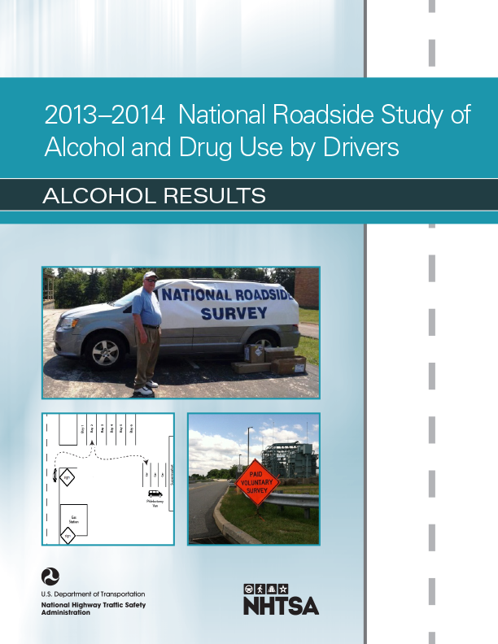
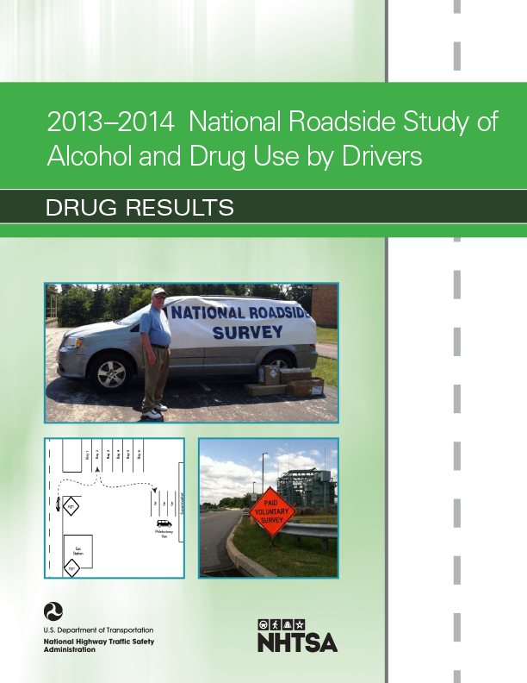
2013-2014 National Roadside Survey of Alcohol and Drug Use by Drivers

Slide 21
NHTSA/IACP-Supported Impaired Driving Programs
Training: SFST; ARIDE; DEC Program; Prosecuting the Drugged Driver; ARIDE Refresher; DRE Expert Testimony
Enforcement: Selective Traffic Enforcement
Prosecution/Judges: Traffic Safety Resource Prosecutors; Judicial Education

Slide 22
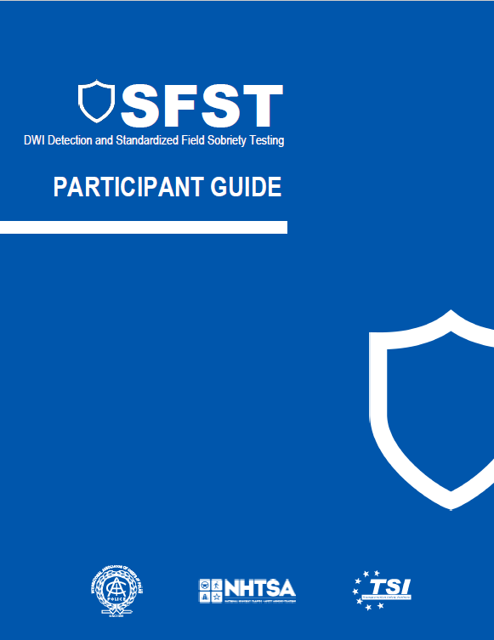
SFST Training

Slide 23
Foundations of ARIDE
DWI Detection Process
Phase One: Vehicle in Motion
Phase Two: Personal Contact
Phase Three: Pre-arrest Screening
SFSTs
HGN
WAT
OLS

Slide 24



Training Programs Aimed At Defeating Impaired Driving
Drug Recognition Expert (DRE)
Advanced Roadside Impaired
Driving Enforcement
Standardized Field Sobriety Testing
1 - 24
Notes:
The three main educational and training programs directed towards efforts related to impaired driving include SFST, or the entry-level step, ARIDE or the mid-range step; and DRE, or the top tier level in impaired driver training.

Slide 25
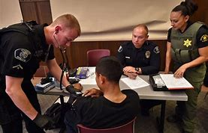
Roles and Responsibilities of a DRE

Slide 26
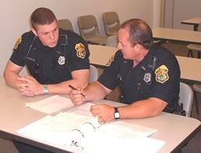
Bridging the Gap
Build on SFST skills
Identify drug-impaired drivers
Support the DEC Program

Slide 27
Questions?

