Slide 1
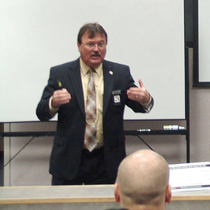



Session 1
Introduction and Overview

Slide 2

Learning Objectives
State goals and objectives
Overview schedule and activities
Describe participant manual contents
Demonstrate pre-training knowledge of training topics

Slide 3

Housekeeping
Paperwork
Mandatory attendance
Breaks
Facility
Interruptions
Electronic devices off

Slide 4

Participant Introductions
Name
Agency affiliation
Experience

Slide 5

PLAY IMPAIRED DRIVING IMPACT VIDEO OF YOUR CHOOSING (OPTIONAL)

Slide 6
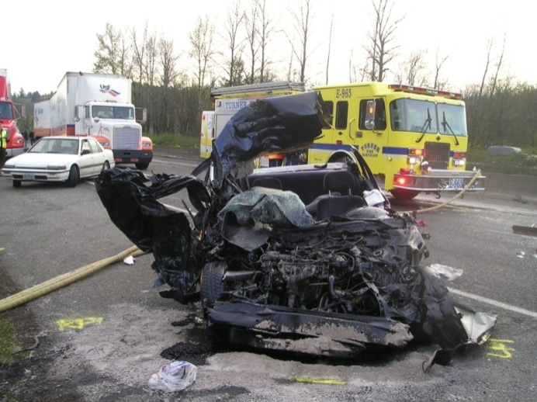
Training Goal
Increase deterrence of DWI violations; thereby reducing the number of crashes, deaths, and injuries caused by impaired drivers.

Slide 7

Enforcement Goals
General DWI deterrence
DWI detection phases, clues, and techniques
DWI case requirements

Slide 8

Alcohol-impaired drivers kill one person every 45 minutes
An average of
people die every day from alcohol-impaired crashes
Alcohol-impaired crashes kill 1 person every
minutes
32
45

Slide 9
State and Local Data
Approximately _____ people now live in _____
About _____ of these people will die in vehicle crashes
About _____ will die in DWI crashes

Slide 10
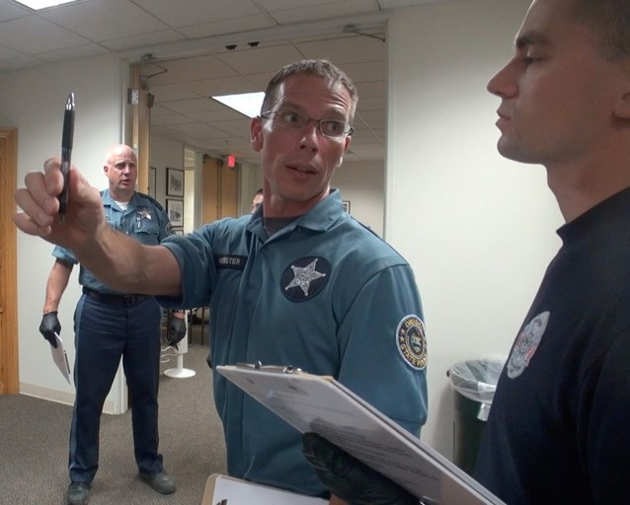
Job Performance Objectives
Recognize evidence
Administer SFSTs
Describe evidence
Video/audio evidence

Slide 11
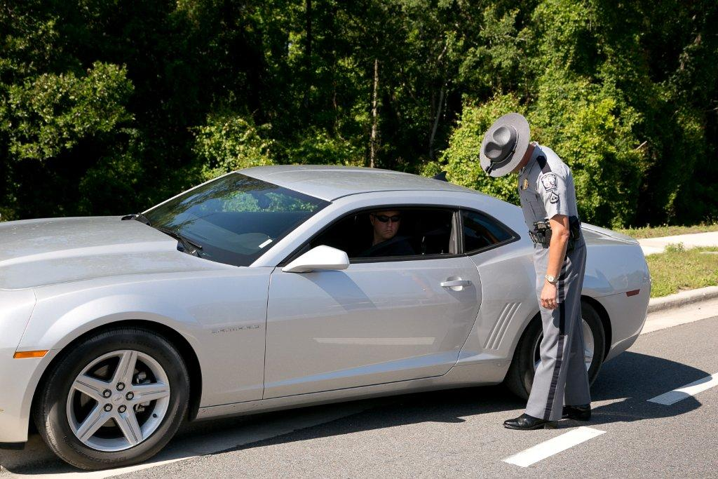
Job Performance Enabling Objectives
Refer to your participant guide

Slide 12

Participant Manual
Training reference
Session notes
Organization of guide
Preview sessions in advance
Review prior to exam

Slide 13


Training Schedule

Slide 14
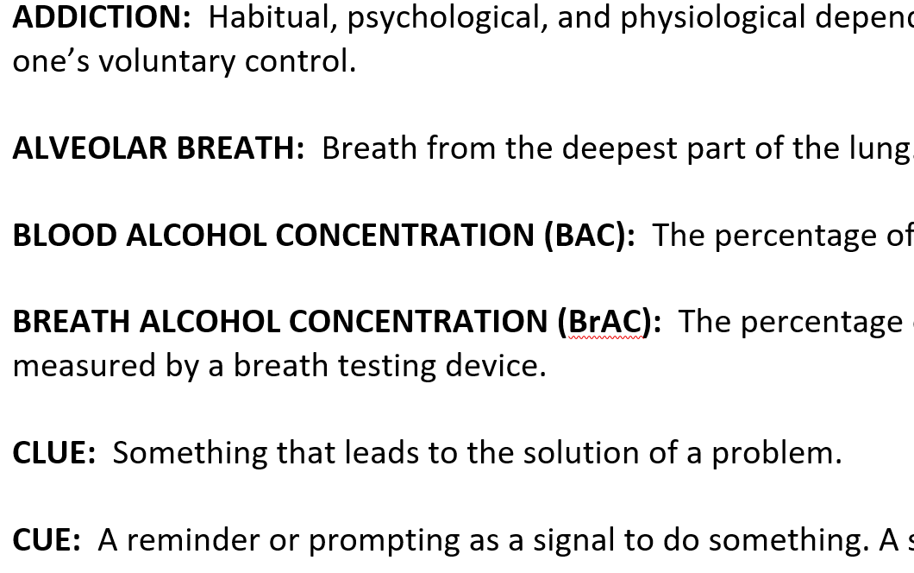
Glossary of Terms

Slide 15
Questions?

