Slide 1



Introduction to Drugged Driving

Slide 2

Learning Objectives
Define term "drug"
Describe drug involvement in motor vehicle crashes
Name categories of drugs

Slide 3
Learning Objectives
Describe signs associated with drug categories
Describe medical conditions
Describe procedures for dealing with drug- or medically-impaired subjects

Slide 4
Session Purpose
Improve your ability to recognize subjects who
may be medically impaired or impaired by drugs
other than alcohol and, when you encounter
such suspects, take appropriate action.

Slide 5

This Training Will NOT…
Qualify you as a DRE.

Slide 6
What is a “Drug”?
“Any substance that, when taken into the
human body, can impair the ability of the
person to operate a vehicle safely.”

Slide 7
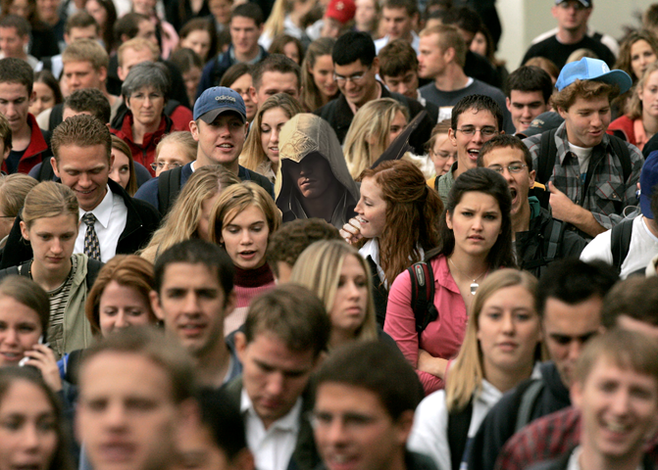
How Many People Use Drugs?
Difficult to determine
Widespread issue

Slide 8
NSDUH Self-Reported Drug Use
In 2020, an estimated 37.3 million Americans aged 12 or older were current (past month) illicit drug users
Marijuana was used by approximately 88 percent of all current illicit drug users

Slide 9
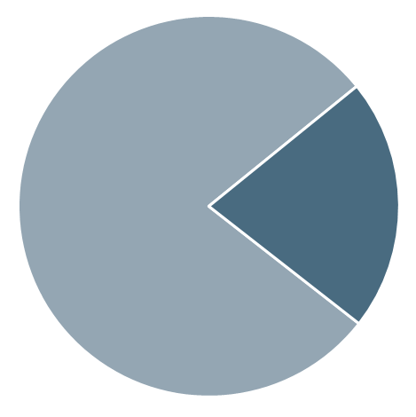
Alcohol and Drug Use
Marijuana
49.6M
Rx Pain Reliever Misuse
9.3M
Past Year
Illicit Drug Use
59.3M People
(21.4%)
Hallucinogens
7.1M
No Past Year
Illicit Drug Use
217.6M People
(78.6%)
Rx Tranquilizer or Sedative Misuse
6.2M
Cocaine
5.2M
Rx Stimulant Misuse
5.1M
Methamphetamine
2.5M
Inhalants
2.4M
Heroin
902,000
0 10 20 30 40 50 60
Number of Past Year Users

Slide 10
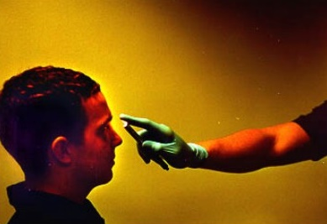
Eye Examinations:
Detecting Signs of Drug Influence

Slide 11
Gaze Nystagmus
Resting Nystagmus – Occurs as eyes gaze straight ahead
HGN
VGN

Slide 12

Resting Nystagmus

Slide 13
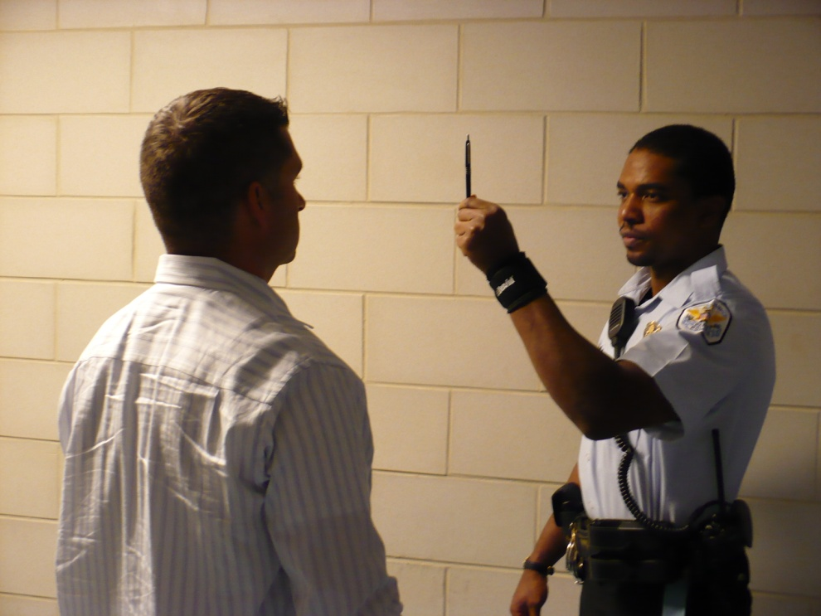
Horizontal Gaze Nystagmus

Slide 14
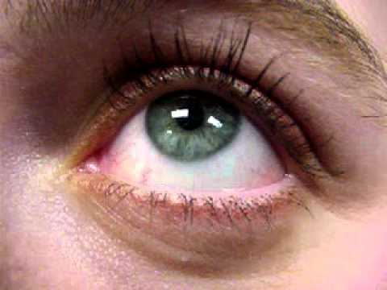
Vertical Gaze Nystagmus

Slide 15
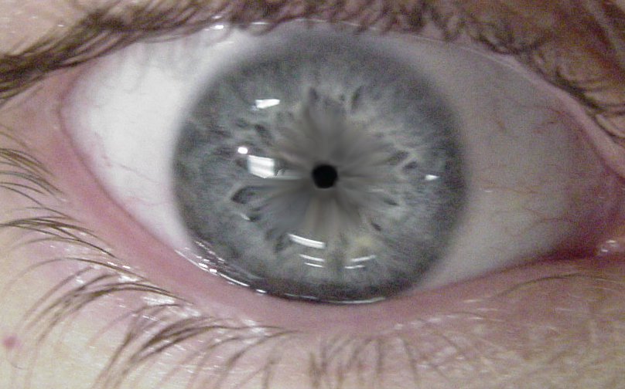
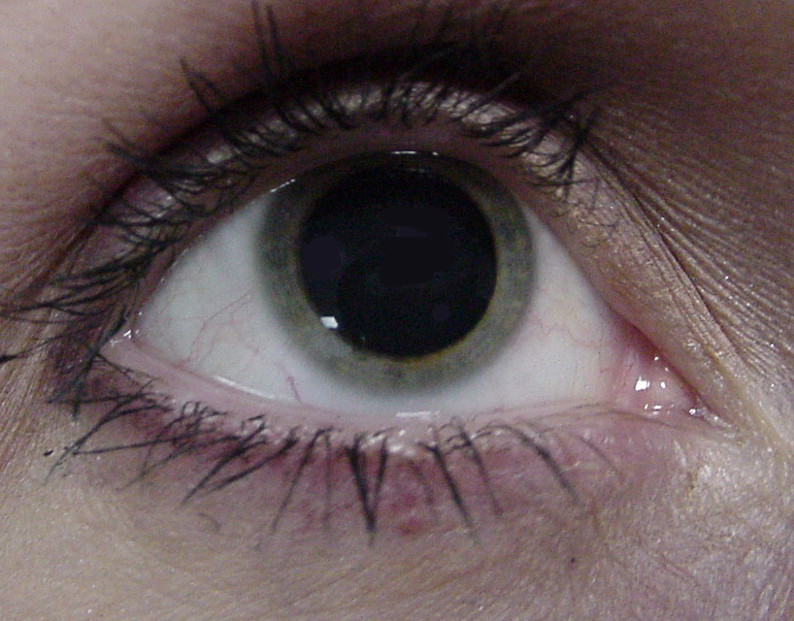
Pupil Size Observations

Slide 16
Dilated Pupils

Slide 17
Constricted Pupils

Slide 18
Medical Conditions That May Mimic Drug Impairment
Head Trauma
Stroke
Diabetes
Conjunctivitis
Shock
Multiple Sclerosis
Other Conditions

Slide 19
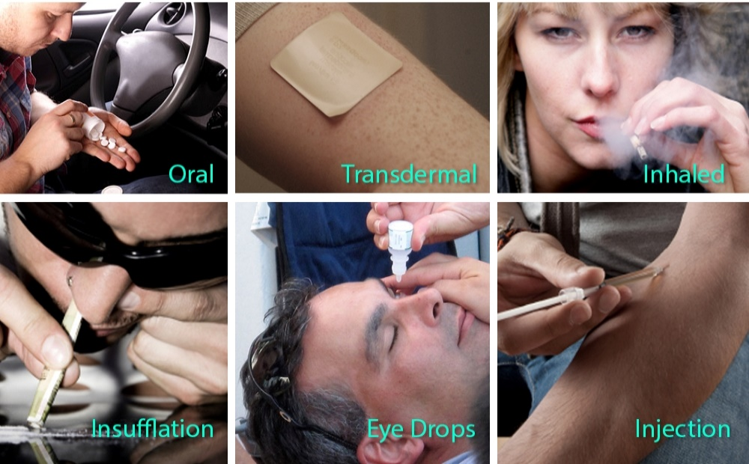
Methods of Administration
Oral
Injection
Insufflation
Inhalation
Transdermal

Slide 20
Drug Categories and Their Observable Effects
CNS Depressants
CNS Stimulants
Hallucinogens
Dissociative Anesthetics
Narcotic Analgesics
Inhalants
Cannabis

Slide 21
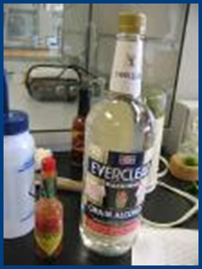
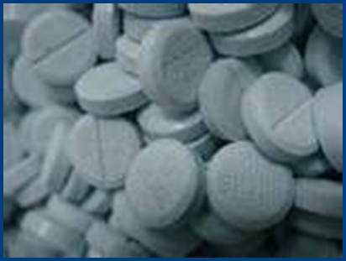
CNS Depressants
Alcohol
Barbiturates (Secobarbital)
Non barbiturates (GHB/Soma)
Anti-Anxiety Tranquilizers (Valium/Xanax)
Antidepressants (Prozac/Elavil)
Muscle relaxants

Slide 22
Indicators of
CNS Depressant Influence
Drunk-like behavior
Thick, slurred speech
Uncoordinated

Slide 23
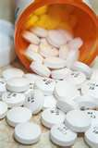
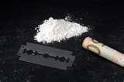
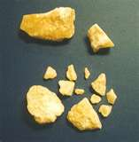
CNS Stimulants
Cocaine
Amphetamines
Methamphetamine

Slide 24

Indicators of
CNS Stimulant Influence
Hyperactive
Nervousness
Talkative

Slide 25
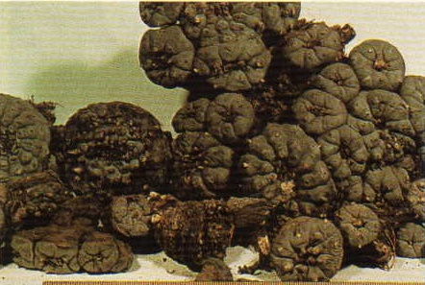
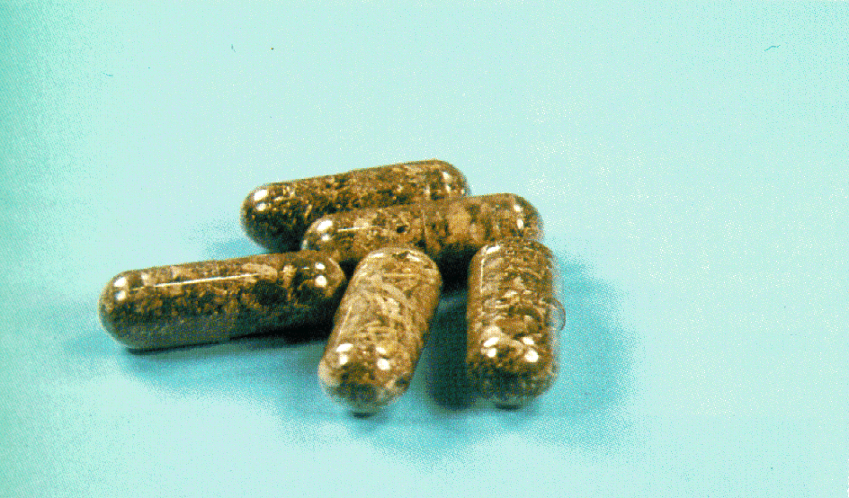
Hallucinogens
Peyote
Salvia Divinorum
LSD
MDMA (Ecstasy)

Slide 26
Indicators of
Hallucinogen Influence
Body tremors
Dazed appearance
Difficulty with speech
Disoriented
Hallucinations
Nausea
Paranoia
Perspiring
Piloerection (goose bumps)
Uncoordinated

Slide 27

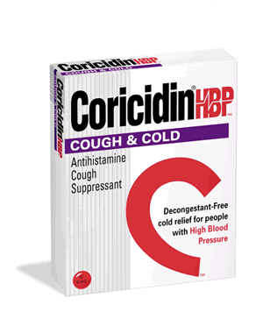
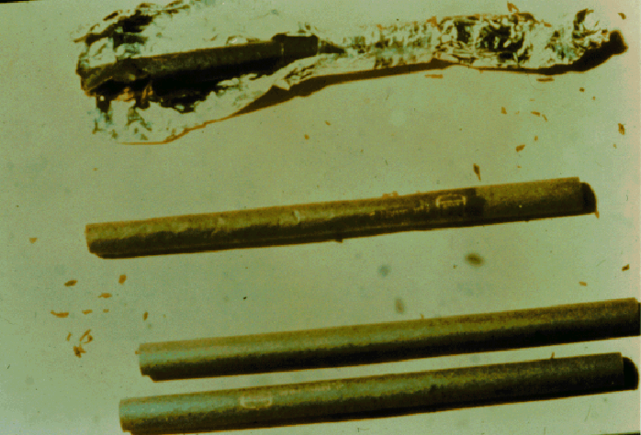
Dissociative Anesthetics
PCP
Ketamine
DXM

Slide 28

Indicators of Dissociative Anesthetic Influence
Blank stare
Confused
Incomplete verbal responses
Muscle rigidity
Perspiring
Possibly violent and combative
Repetitive speech
Warm to touch

Slide 29
Narcotic Analgesics
Heroin
Morphine
Codeine
Synthetic Opiates (e.g., Methadone, Fentanyl)

Slide 30

Indicators of
Narcotic Analgesic Influence
Depressed reflexes
Droopy eyelids
Dry mouth
Itching
“On the nod”
Puncture marks may
be evident
Slow, low, raspy speech

Slide 31
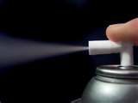
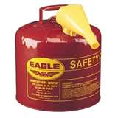

Inhalants
Various glues
Paint
Gasoline
Aerosol sprays
Nitrous Oxide
Ether
Amyl Nitrite

Slide 32
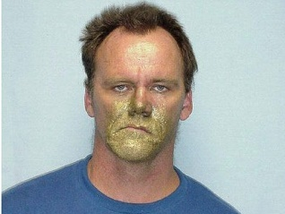
Indicators of Inhalant Influence
Confused
Disoriented
Possible nausea
Residue of substance
Slow, thick, slurred speech

Slide 33
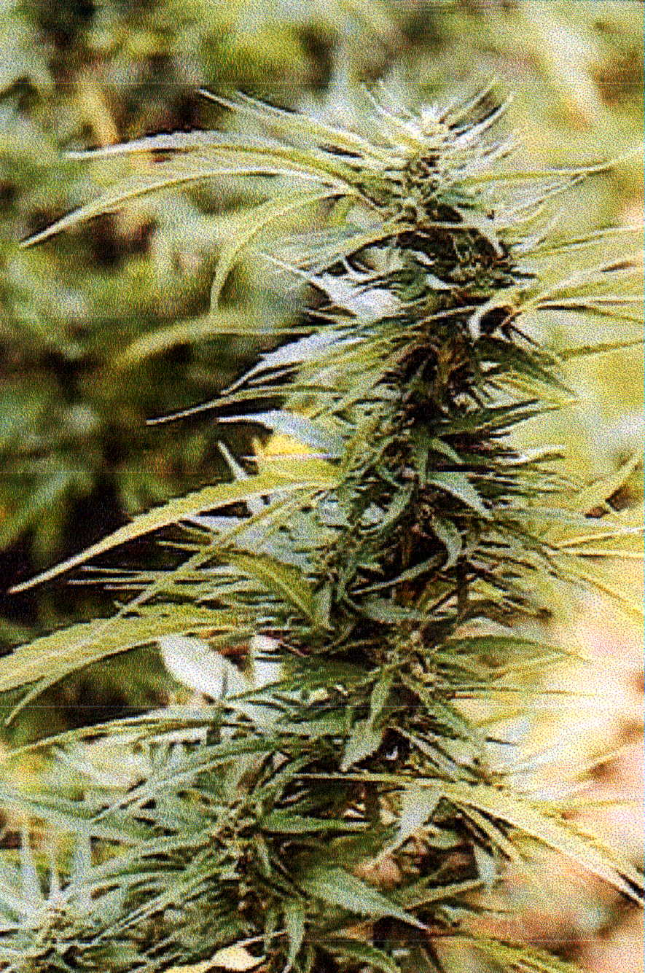
Cannabis
Marijuana
Hashish
Hash oil
Synthetic Cannabinoids
Other forms of Cannabis

Slide 34
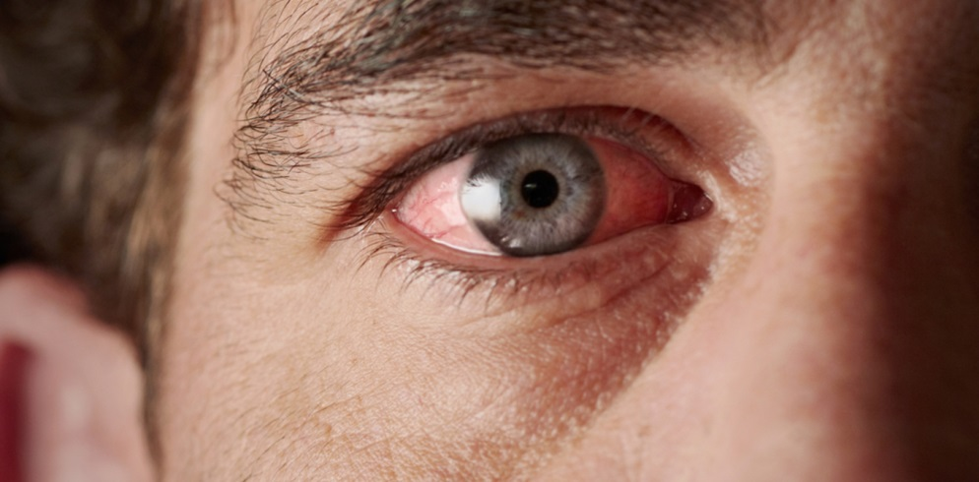
Indicators of Cannabis Influence
Bloodshot eyes
Body tremors
Disoriented
Odor of marijuana
Relaxed inhibitions

Slide 35
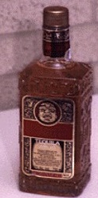

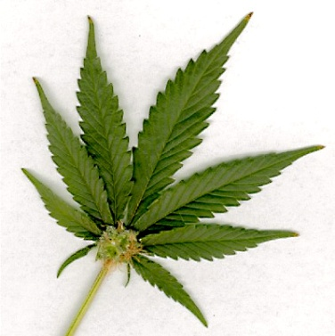

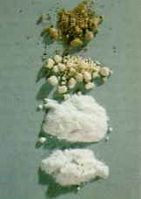
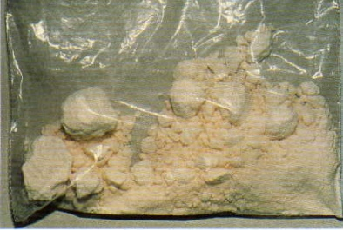
Common Combinations of Drugs
Alcohol and some
other drug
PCP and Cannabis
Cocaine and Heroin

Slide 36
Dealing With Suspected Drug Influence or Medical Impairment

Slide 37
Questions?

