Slide 1
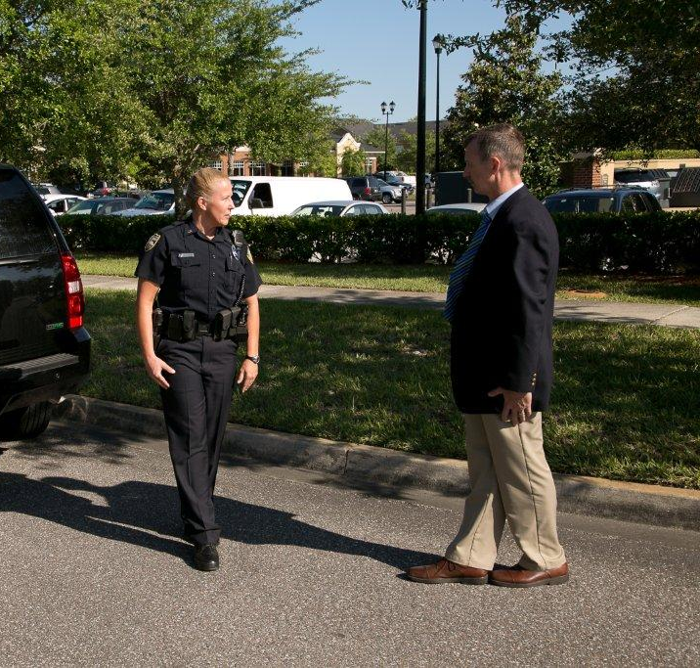



Session 3
Standardized Field Sobriety Testing Review

Slide 2

Learning Objectives
  Understand results of selected SFST validation studies
  Define, describe, properly administer SFSTs
  Define nystagmus and distinguish between different types

Slide 3
Learning Objectives
Recognize, document, and articulate indicators and clues of the three SFSTs
Identify limitations of the three SFSTs

Slide 4
Overview:
Development and Validation
NHTSA research began in 1975 in California
Three final reports published
  California: 1977 (lab study only)
  California: 1981 (lab/field study)
  Maryland, Washington, DC, Virginia,
  North Carolina: 1983 (field study only)

Slide 5
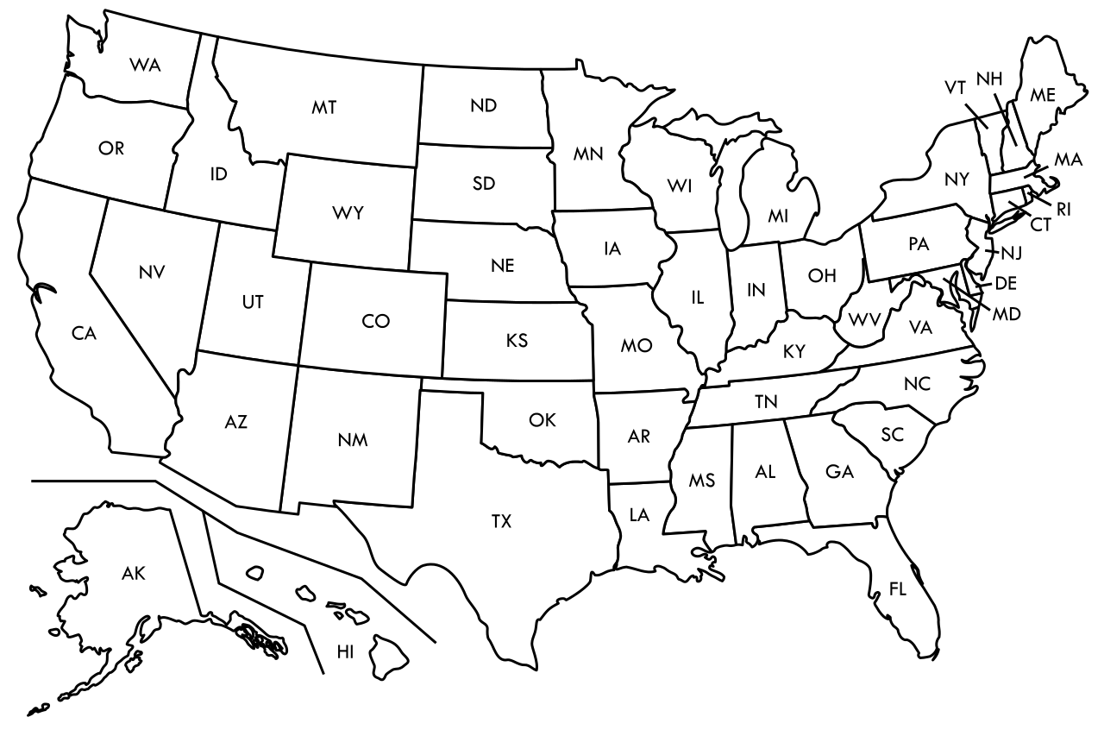
SFST Field Validation Studies

Slide 6
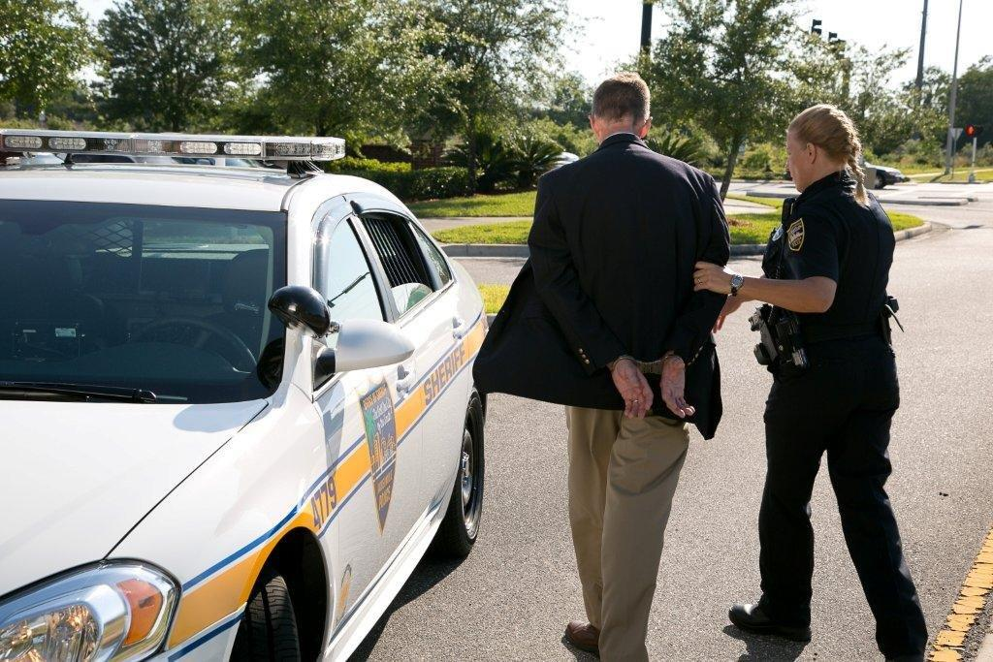
“Correct” and “Incorrect”
Arrest Decisions

Slide 7
Colorado Field Validation
Study of SFST
First full field validation study using SFST-experienced law enforcement
86% correct arrest/release decision based on three SFSTs
93% of those arrested had a BAC of 0.05 or higher

Slide 8
Florida Field Validation
Study of SFST
95% correct arrest decision based on three SFSTs
Validated SFSTs at 0.08 BAC and above

Slide 9
San Diego Field Validation
Study of SFST
91% correct-arrest decision for 0.08 BAC and above using three SFSTs
HGN is still most reliable of three SFSTs and supports arrest decisions at 0.08 BAC

Slide 10
San Diego Field Validation
Study of SFST

Slide 11
Categories of Nystagmus
Vestibular
Neural
Pathological Disorders and Diseases

Slide 12

Gaze Nystagmus
    Horizontal
    Vertical
    Resting

Slide 13

Horizontal Gaze Nystagmus
Involuntary jerking of eyes, occurring as eyes gaze
to side

Slide 14
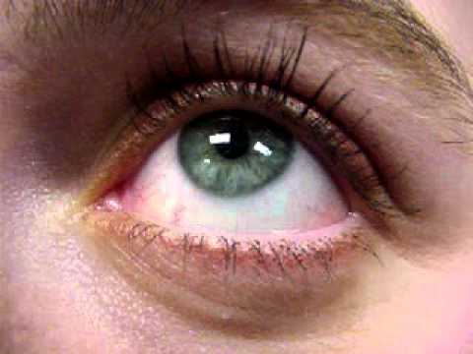
Vertical Gaze Nystagmus
Involuntary jerking of eyes (up and down)

Slide 15
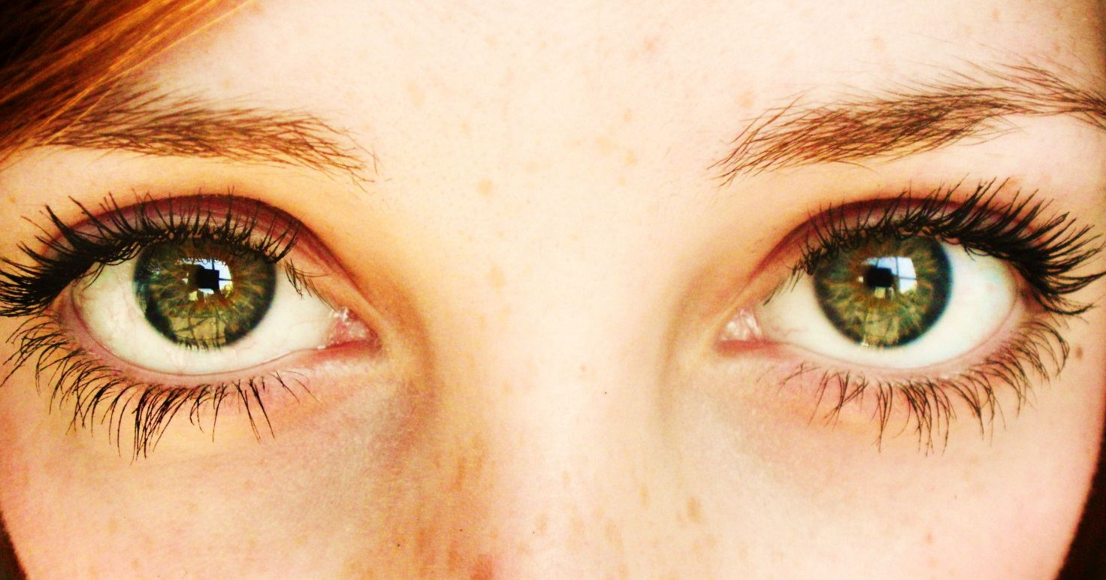
Resting Nystagmus
Jerking of eyes as they look straight ahead

Slide 16
Pathological Disorder Nystagmus
Brain tumors and other brain damage
Some inner ear diseases
Rare in the driving population

Slide 17
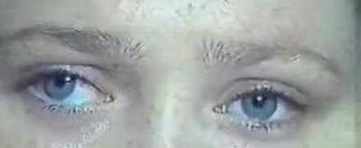
Horizontal Gaze Nystagmus Medical Impairment
Assessment Procedures
Check eyes for:
Equal Pupil Size
Resting Nystagmus
Equal Tracking

Slide 18
Horizontal Gaze Nystagmus Testing: Three Clues
Lack of Smooth Pursuit
Distinct and Sustained Nystagmus at
Maximum Deviation
Onset of Nystagmus Prior to 45 Degrees

Slide 19
Administrative Procedures
Check for eyeglasses
Verbal instructions
Position stimulus (12-15 inches and slightly above eye level)
Check for Equal Pupil Size and Resting Nystagmus
Check for Equal Tracking

Slide 20
Administrative Procedures
Lack of Smooth Pursuit
Distinct and Sustained Nystagmus at
Maximum Deviation
Onset of Nystagmus Prior to 45 Degrees
Total the clues
Check for Vertical Nystagmus

Slide 21
Horizontal Gaze Nystagmus Procedures
Check for eyeglasses
Verbal instructions
Position stimulus

Slide 22
Horizontal Gaze Nystagmus Procedures
Equal Pupil Size and Resting Nystagmus
Equal Tracking

Slide 23
Horizontal Gaze Nystagmus Procedures
Check for Lack of Smooth Pursuit
Check for Distinct and Sustained Nystagmus at Maximum Deviation
Check for Onset of Nystagmus Prior to 45 Degrees

Slide 24
Horizontal Gaze Nystagmus Procedures
Total the clues
Check for Vertical Gaze Nystagmus

Slide 25
Test Interpretation
Look for three clues of nystagmus in each eye:
Lack of Smooth Pursuit
Distinct and Sustained Nystagmus at Maximum Deviation
Onset of Nystagmus Prior to 45 Degrees

Slide 26
Three Clues of Horizontal Gaze Nystagmus
Lack of Smooth Pursuit
Distinct and Sustained Nystagmus at Maximum Deviation
Onset of Nystagmus Prior to 45 Degrees

Slide 27
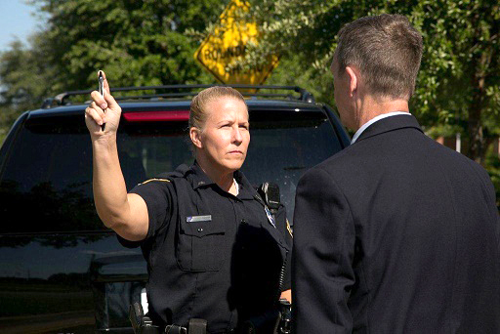
Clue Number 1
Lack of Smooth Pursuit

Slide 28

Clue Number 1
Lack of Smooth Pursuit

Slide 29
Mechanics of Clue Number 1
Move object steadily at a speed
that takes approximately 2 seconds
to bring the eye from center to side

Slide 30
Clue Number 2
Distinct and Sustained Nystagmus
at Maximum Deviation

Slide 31
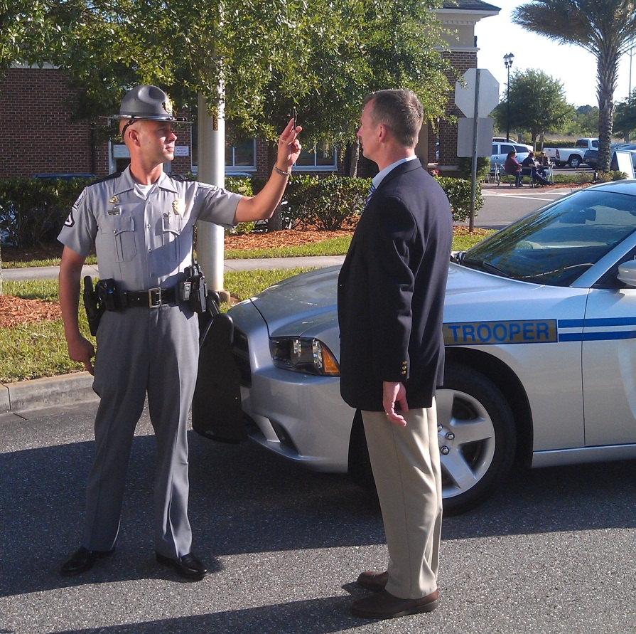
Clue Number 2
Distinct and Sustained Nystagmus
at Maximum Deviation

Slide 32
Clue Number 3
Onset of Nystagmus Prior to 45 Degrees

Slide 33
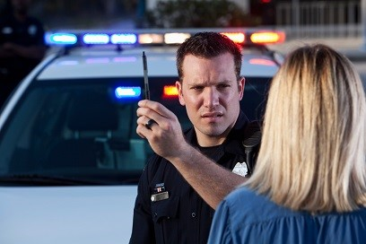
Clue Number 3
Onset of Nystagmus Prior to 45 Degrees

Slide 34

Mechanics of Clue Number 3

Slide 35
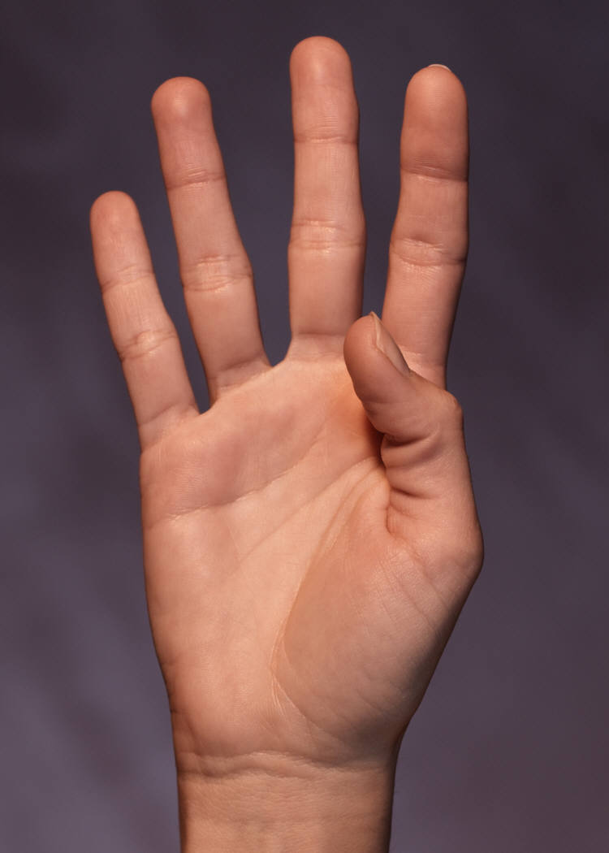
Horizontal Gaze Nystagmus Test Criterion
4 or more clues indicates
BAC above 0.08 (88% accurate)

Slide 36
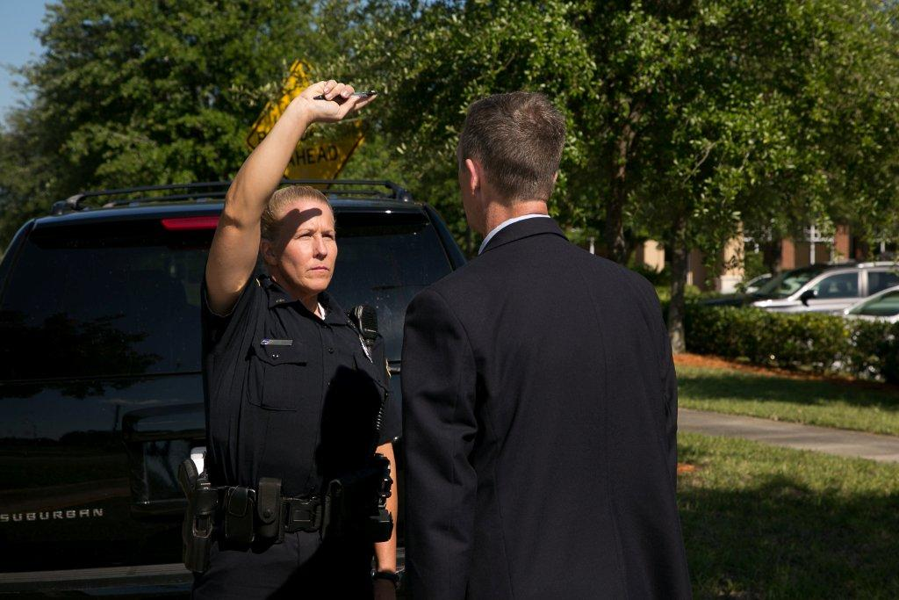
Vertical Gaze Nystagmus

Slide 37
Horizontal Gaze Nystagmus Demonstration

Slide 38
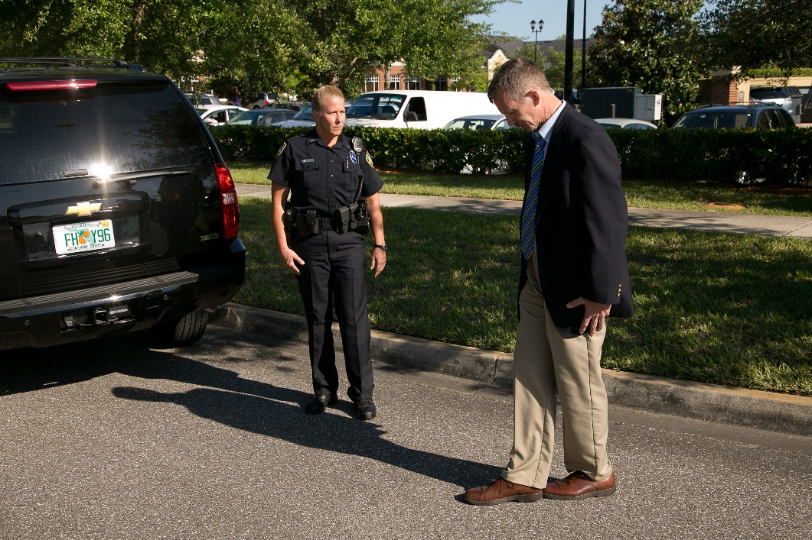
Walk and Turn
Divided Attention Test
Mental Task and Physical Task
Instruction stage
Walking stage

Slide 39
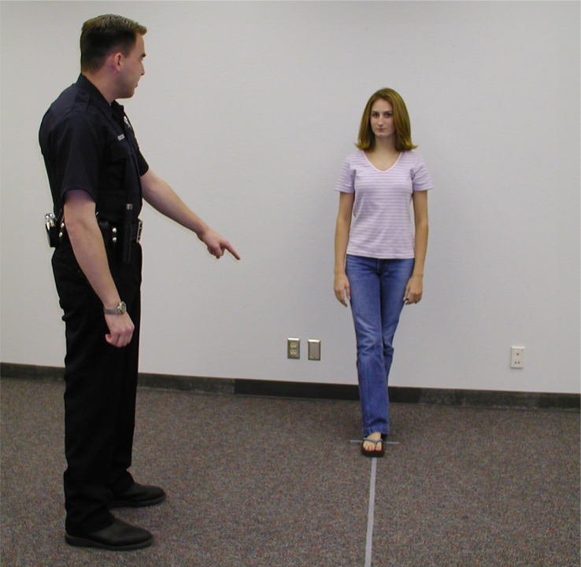
Safety Precautions

Slide 40
Administrative Procedures
Instruction Stage
Verbal Instructions
  Assume heel-to-toe stance
  Arms down at sides
  Don’t start until told

Slide 41
Administrative Procedures
Walking Stage
Nine heel-to-toe steps, turn, nine heel-to-toe steps
Turn procedures:
  Turn around on the line
  Several small steps

Slide 42
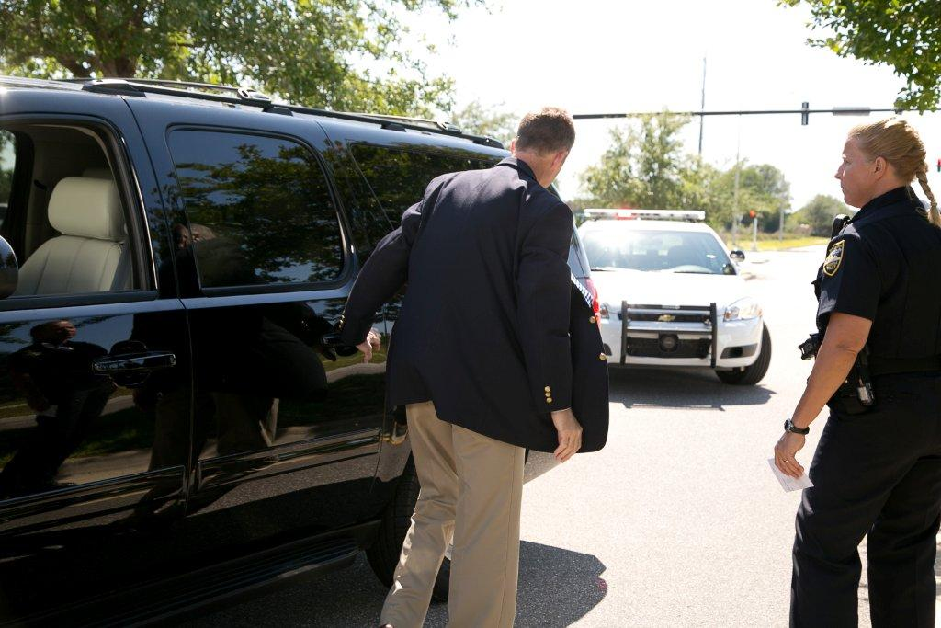
Instruction Stage Clues
Cannot keep balance while listening to instructions
Starts too soon

Slide 43
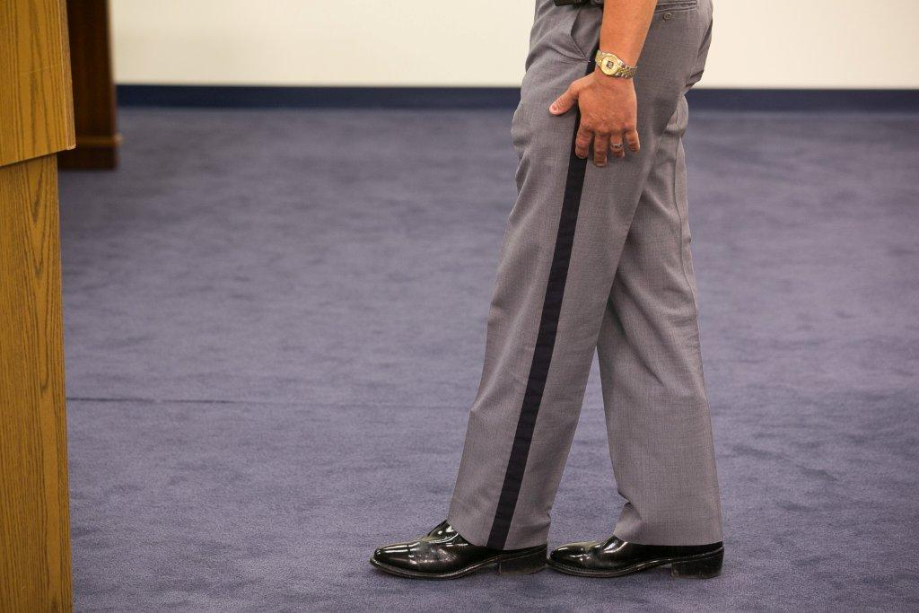
Walking Stage Clues
Stops while walking
Does not touch heel-to-toe
Steps off the line
Uses arm(s) to balance
Improper turn
Incorrect number of steps

Slide 44
Walk and Turn Test Clues Summary
SFSTs are a tool to assist you in seeing visible signs of impairment and are not a pass/fail test.

Slide 45
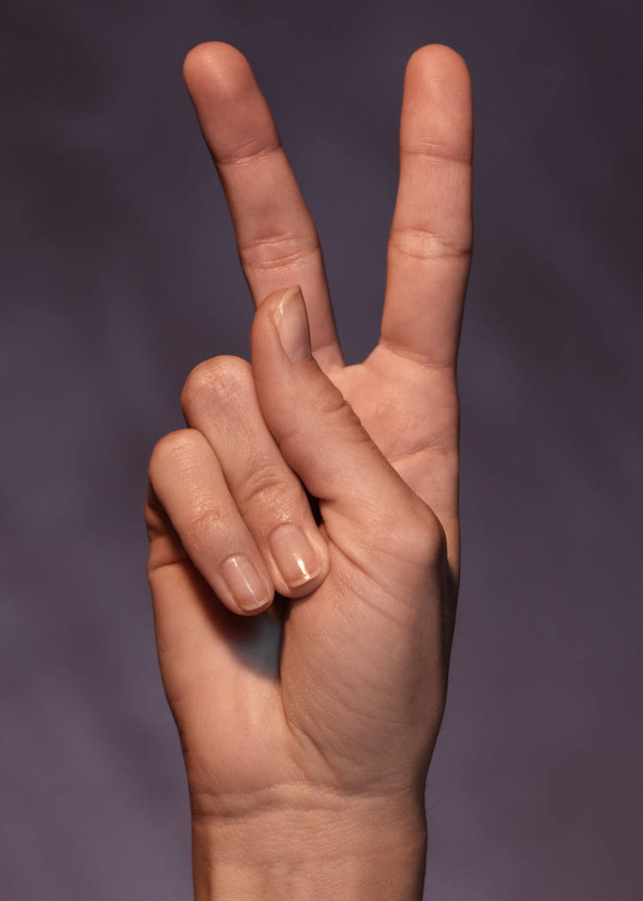
Walk and Turn Test Criterion
2 or more clues indicates BAC
at or above 0.08 (79% accurate)

Slide 46
Walk and Turn Demonstration

Slide 47
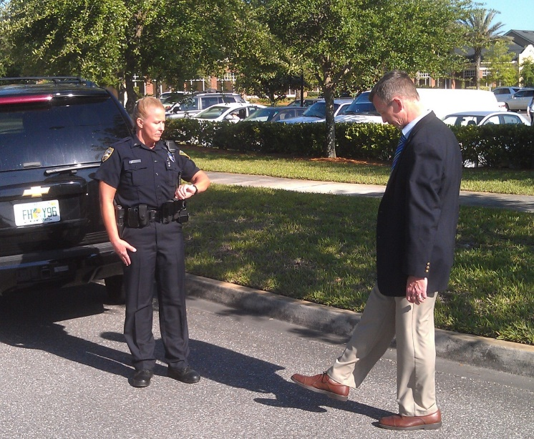
One Leg Stand
Divided Attention Test
Mental Task and Physical Task
Instruction stage
Balance and counting stage

Slide 48
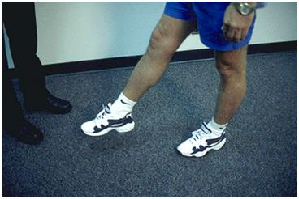
Administrative Procedures
Instruction Stage
  Stand straight, feet together
  Keep arms at sides
  Maintain position until told otherwise

Slide 49
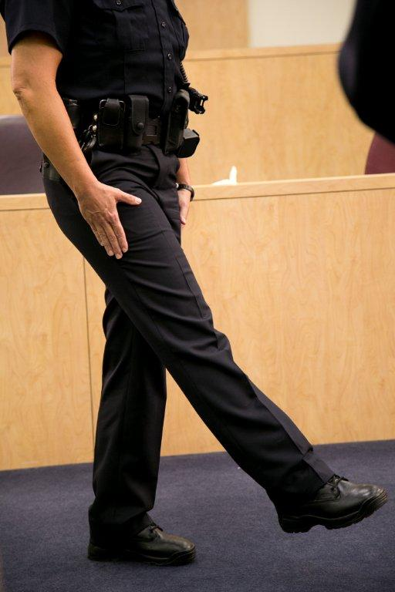
Administrative Procedures
Balance and Counting Stage

Slide 50
One Leg Stand Test Clues
Sways while balancing
Uses arm(s) to balance

Slide 51
One Leg Stand Test Clues
Hopping
Puts foot down

Slide 52
One Leg Stand Test Criterion
2 or more clues indicates BAC
at or above 0.08 (83% accurate)

Slide 53
One Leg Stand Demonstration

Slide 54
Questions?

