Slide 1



Session 4
Written Examination
and Program Conclusion

Slide 2

Learning Objectives
  Demonstrate knowledge and proficiency in administering SFSTs
  Complete written examination with passing grade
  Provide comments and suggestions for improving course

Slide 3
Proficiency Examination

Slide 4
Detection Phases
What are the three phases of detection?
What is the definition of “DWI detection"?
What is the police officer's principal decision during Detection Phase One?
During Phase Two?
During Phase Three?

Slide 5
Field Sobriety Testing
What does "nystagmus" mean?
WAT is an example of a ______________ attention test
Name the eight distinct clues of WAT
Name the four distinct clues of OLS
Name the three distinct clues of HGN

Slide 6
Field Sobriety Testing
What is the critical angle for determining whether the third clue of HGN is present?
How many steps in each direction must the subject take in the WAT test?
How long must the subject stand on one foot in the OLS test?

Slide 7
Field Sobriety Testing
In the WAT test, a subject who steps off the line during the first 9 steps and once again during the second 9 steps and who uses arm(s) to balance twice during the second 9 steps has produced ____ distinct clue(s).
How reliable is each test using the San Diego study?

Slide 8
Post Test
“Closed book”
Passing score is 80%
Approximately 15-20 minutes to complete

Slide 9
Course Critique

Slide 10
Review of Post Test

Slide 11
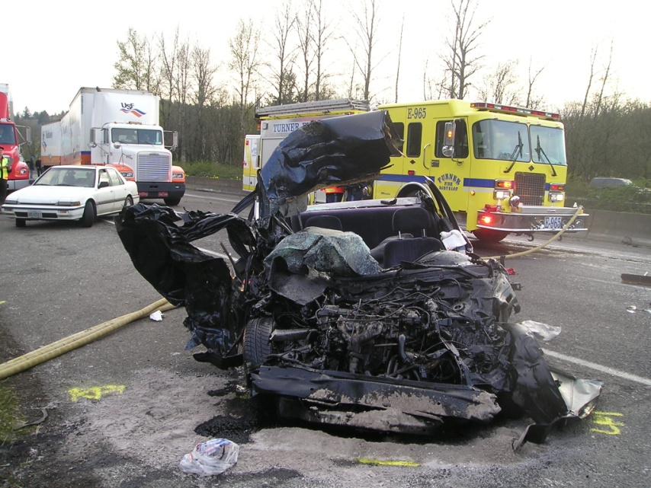
Ultimate Goal
Increase DWI Deterrence and Decrease Alcohol Related Crashes, Deaths and Injuries.

Slide 12
Job Performance Objectives
You will become better able to:
  Recognize and interpret evidence of DWI violations
  Administer and interpret validated psychophysical SFSTs
  Describe DWI evidence clearly and convincingly

Slide 13
Questions?

