Slide 1



DWI Detection & SFST
Instructor
Development
Course
Session 1 – Introduction
February, 2017

Slide 2

Content Segments
Welcome
Facilities, Logistics, Classroom Conduct
Course Format
Introduction
Final Participation Demonstration
Questions and/or Concerns
Notes:
Session 1: Introduction to the DWI Detection and SFST Instructor Development Course (IDC)
Estimated time for Session 1: 2 Hours (depending on class size)
Session Objectives
Using the provided agenda, review course objective and other administrative matters
Using the windowpane exercise, demonstrate the Cycle of Instruction with the participants to be discussed in Session 2
Using the windowpane exercise, participants will express expectations of the course
Participants are expected to actively engage in course activities
Contents
A. Welcome
B. Facilities, Logistics And Classroom Conduct
C. Course Format
D. Introduction
E. Final Participation Demonstration
F. Questions and/or Concerns
Materials
Presentation slides Self-Adhesive Easel/Easel Pad
Colored Dry-Erase Markers Tape
Copy of agenda/schedule Participant list
Tent cards and/or name tags
Pre-test
Computer speakers (for embedded videos)
Instructional Notes are presented in bold italic throughout the sessions.

Slide 3

DWI Detection and SFST
Instructor Development Course
Session 1:
Introduction
Notes:
Welcome
Optional Exercise: Instructors may want to utilize the optional exercise contained within the Administrator Guide for this session.
Welcome to the DWI Detection and Sobriety Field Standardized Training (SFST) Instructor Development Course
Stress the importance of open communication, effective feedback and participation.
Session 1: Introduction
Estimated time for Session 1: 2 Hours
Materials:
Presentation slides
Self-Adhesive Easel/Easel Pad
Colored Dry Erase Markers
Tape
Copy of agenda/schedule
Participant list
Tent cards and/or name tags
Pre-test
Computer speakers (for embedded videos)

Slide 4

Session Objectives
Review course objectives and other administrative matters
Discuss expectations of course
Discuss participant expectations in course
Notes:
Session Objectives
At the conclusion of this session, participants should be able to:
Review course objectives and other administrative matters
Discuss expectations of the course
Discuss participant expectations in the course
Demonstrate the Cycle of Instruction (Optional)
___________________________________________________________________________
___________________________________________________________________________
___________________________________________________________________________
___________________________________________________________________________
___________________________________________________________________________
___________________________________________________________________________
___________________________________________________________________________
___________________________________________________________________________
___________________________________________________________________________

Slide 5
Course Goals and Objectives
Learning strategies and training effectiveness
Facilitation skills
Effective questioning skills
Handling common problem situations
Standard NHTSA/IACP SFST lesson plans
Training aids
Notes:
Course Goals and Objectives
This course will provide you with specific information on how to effectively train and motivate SFST practitioners.
You will be able to:
Describe how learning strategies contribute to training effectiveness
Apply facilitation skills
Apply effective questioning skills
Apply effective strategies for handling common problem situations
Use the standard NHTSA/IACP SFST lessons plans
Develop and use training aids
___________________________________________________________________________
___________________________________________________________________________
___________________________________________________________________________
___________________________________________________________________________
___________________________________________________________________________
___________________________________________________________________________
___________________________________________________________________________

Slide 6

Notes:
B. Facilities, Logistics and Classroom Conduct
Circulate a copy of the roster for participants to verify if information is correct or if changes need to be made. Inform participants a copy of the completed roster will be given to each participant at the completion of the course.
Take a few minutes to describe the facilities and logistics of the particular location. Include directions to restrooms, vending machines, and/or location of refreshments.
Discuss building layout, including: emergency exits, fire extinguishers, fire alarm pull stations, and meeting area in case of a building evacuation.
___________________________________________________________________________
___________________________________________________________________________
___________________________________________________________________________
___________________________________________________________________________
___________________________________________________________________________
___________________________________________________________________________
___________________________________________________________________________
___________________________________________________________________________

Slide 7

Course Etiquette
Be respectful
No disparaging remarks
Be on time
Do not surf the internet or conduct business while the course is in session
Cell phone off or in vibrate mode
Active participation
Notes:
Explain participants need to be respectful to other participants as well as the host property.
Remind participants we want to hear about successes, lessons learned, and challenging situations.
Remind participants to turn cell phones off or put them in vibrate mode and do the same to yours.
Tell participants participation in class discussion is encouraged.
Course Etiquette
Be respectful
No disparaging remarks
Be on time
Do not surf the internet or conduct business while the course is in session
Cell phone off or in vibrate mode
Active participation
___________________________________________________________________________
___________________________________________________________________________
___________________________________________________________________________
___________________________________________________________________________

Slide 8

Course Format
Active participation is required
Interactive
Participant Manual
Breaks and lunch
Additional activities
Notes:
C. Course Format
Ask participants if they have a copy of the agenda. Review daily agenda for course. Briefly review the week’s schedule and procedures to be followed. This is very important as you will be discussing why you did this during Session 2.
Emphasize: This course is intended to make you an effective SFST instructor.
This course is participant-dependent, which means active participation is required. Give the participants a sense of responsibility for the process.
Interactive teaching methods will be used, including facilitated group discussions, games, and activities.
Participant manual: Explain the participant manual contains the training visuals and curriculum used throughout the course. Space is provided for note taking throughout the manual. Encourage participants to use the manual as a learning aid for reviewing the information presented.
Tour Your Manual: Make sure to direct participants to sections and let them look through the manual to see the tabs, resources, etc. Be certain to point out centrally-located resources used repeatedly throughout the course, if applicable. Additional activities may include Live Alcohol Workshop, Introduction to Drugged Driving, Legal Update and Case Law.
Course Format
Schedule and agenda
Breaks
Lunch
Evaluations
SFST IDC and Proficiency Exam

Slide 9

Course Evaluation
Notes:
Inform participants how the course will be evaluated. Review evaluation instructions (i.e., paper evaluations, online evaluations and/or post course evaluations).
Optional Exercise (Only discuss this if the optional exercise on page 1 was used.)
Break participants into small groups (4 or 5). Ask each group to critique what was good about opening the class and what needed improvement. Each group will select a spokesperson to report back to the class.
Objective: Initiate discussion with participants regarding what was accomplished through this exercise. Elicit these points:
All participants should have been involved in the learning process by being asked to critically assess instructors and classroom conditions
Some participants should have been involved in making presentations to the class regarding their group’s observations of the exercise
___________________________________________________________________________
___________________________________________________________________________
___________________________________________________________________________
___________________________________________________________________________
___________________________________________________________________________
___________________________________________________________________________

Slide 10

Introductions
Notes:
D. Introduction
The following activity includes an introduction of all instructors and participants. Be enthusiastic and use humor appropriately. Humor conveys a relaxed, comfortable environment.
ACTIVITY: Windowpane
Objectives: Participants will create a windowpane using an easel/easel pad. Each participant will stand before the group, give a presentation, state their expectations of the course, and provide the faculty with insight into their experience.
Supplies Needed: Multiple self-adhesive easels/easel pads and multiple packages of colored markers.
Instructors should put an example of their windowpanes up in the classroom as an example. One of the instructors may construct a windowpane in only 1 color that is not easily readable, such as yellow or orange. The instructor who teaches Session 3 will later use this pane for a teaching moment when he or she covers the use of color and impact. After the panes are completed, the lead instructor will present his/her windowpane to the group, taking no more than two minutes. Next, the participants and instructors will present their panes. Whenever they finish their presentations, participants should take/stick the windowpanes to the wall in the main room.
Instructions: Give each participant a self-adhesive sheet of paper. The instructors should put examples of the windowpane at the front of the class for participants to see and copy. Have them respond to the questions presented. Advise them they will be presenting their windowpane to the group as a whole. Also let them know their windowpanes will remain posted in the classroom for the remainder of the course. * Additional instruction for the windowpane activity is provided on the next page.

Slide 11

Introductions
Name
Agency
Experience as
Law Enforcement
Officer (Years)
Experience Teaching
(Years)
Your Ideal Job
(Pictures Can
Be Used)
Goal for the
Course
Notes:
Introductions
Name and agency
Experience teaching (years)
Experience as a law enforcement officer (years)
Goal for the course
Your ideal job (pictures can be used)
Whenever the instructors finish their presentations, allow 10 minutes for participants to create their own windowpanes. Participants should tape/stick the windowpanes to the wall in the main room. Allow each participant 2-3 minutes to present their windowpanes.
Name: For identification purposes
Experience: The purpose of this particular windowpane is to open up the discussion of prior work and presentation experience.
Goal for the course: Have the participant verbalize at the beginning of the training what they hope to gain by the completion of the course.
Your ideal job: A picture or drawing can be used to help describe the participant’s ideal job (helps emphasize the importance of visual aids in trainings.)
__________________________________________________________________________________
__________________________________________________________________________________
__________________________________________________________________________________
__________________________________________________________________________________

Slide 12

Notes:
The lead instructor will review the listed expectations identified by the participants on their windowpanes. Instructors will do their best to meet as many of the listed expectations as possible by the course’s conclusion.
Thank the participants for their windowpane examples.
___________________________________________________________________________
___________________________________________________________________________
___________________________________________________________________________
___________________________________________________________________________
___________________________________________________________________________
___________________________________________________________________________
___________________________________________________________________________
___________________________________________________________________________
___________________________________________________________________________
___________________________________________________________________________
___________________________________________________________________________

Slide 13
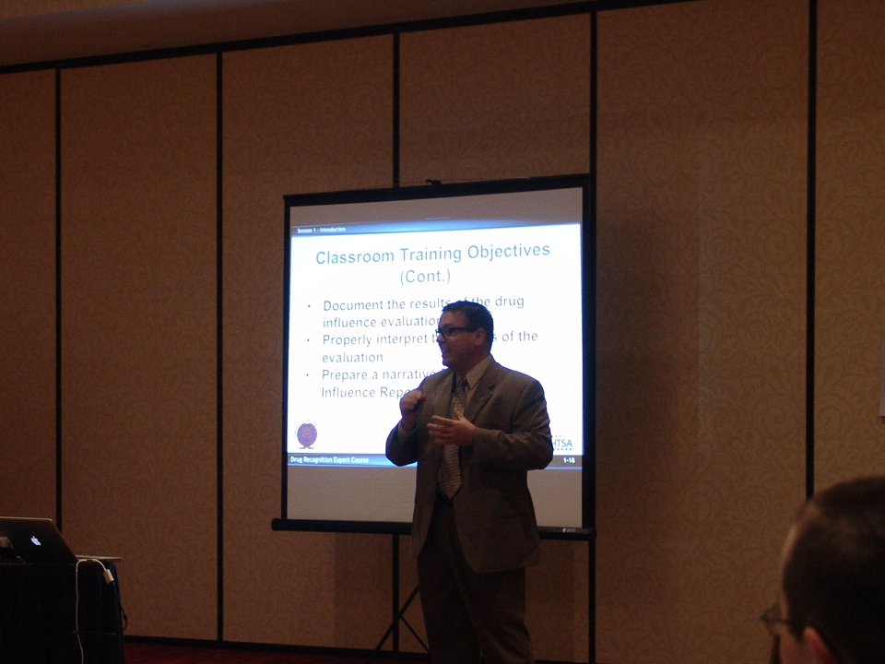
Presentations
Notes:
E. Final Participation Demonstration
Explain to participants they will be required to present a portion of the SFST curriculum as assigned. Participants will also be required to provide effective feedback to other participants’ presentations.
Advise participants they will be provided sufficient time and resources to prepare their demonstration. In addition, participants will be required to successfully complete a final DWI Detection and SFST written examination (scoring an 80% or better) and demonstrate coaching proficiency in the SFST battery.
To successfully complete the course, participants must accomplish the following:
Classroom presentations
Provide presentation feedback to other participants
Written examination (minimum of 80%)
Conduct coaching proficiency
___________________________________________________________________________
___________________________________________________________________________
___________________________________________________________________________
___________________________________________________________________________
___________________________________________________________________________

Slide 14

Questions and/or Concerns
Notes:
F. QuestionS AND/OR CONCERNS
Inquire if any participants have any questions or concerns.
Address as many of the questions and/or concerns as time allows.
Disseminate the Pre-test and allow 10 - 15 minutes to complete.
If time allows, review the exam and the acceptable answers.
___________________________________________________________________________
___________________________________________________________________________
___________________________________________________________________________
___________________________________________________________________________
___________________________________________________________________________
___________________________________________________________________________
___________________________________________________________________________
___________________________________________________________________________
___________________________________________________________________________

