Slide 1



DWI Detection & SFST
Instructor
Development
Course
Session 10 – Guidelines for Conducting Video Workshops for SFST Training
February, 2017

Slide 2

Content Segments
Overview
Procedures for Using Videos
Use and Maintenance of the SFST Log
Questions and/or Concerns
Notes:
Session 10: Guidelines for Conducting Video Workshops for SFST Training
Estimated time for Session 10: 1 Hour (depending on class size)
Session Objectives
Discuss the use of NHTSA/IACP videos of drinking subjects in SFST Training
Coordinate the presentation of the NHTSA/IACP videos to provide for an efficient and effective learning experience
Describe the two options for SFST Training
Describe the maintenance and use of the SFST Log
Contents
Overview
Procedures for Using Videos
Use and Maintenance of the SFST Log
Questions and/or Concerns
Materials
Presentation slides
SFST Instructor Guide
Video worksheets
“Dry Lab” workshop videos
Computer speakers (for embedded videos)
Instructional Notes are presented in bold italic throughout the sessions.

Slide 3

DWI Detection and SFST
Instructor Development Course
Session 10:
Guidelines for Conducting
Video Workshops for SFST Training
Notes:
Session 10: Guidelines for Conducting Video Workshops for SFST Training
Estimated Time for Session 10: 1 Hour
Materials
Presentation slides
SFST Instructor Guide
Video worksheets
“Dry Lab” Option Videos
Computer speakers (for embedded videos)
__________________________________________________________________________
__________________________________________________________________________
__________________________________________________________________________
__________________________________________________________________________
__________________________________________________________________________
__________________________________________________________________________
__________________________________________________________________________
__________________________________________________________________________

Slide 4

Session Objectives
Discuss NHTSA/IACP videos of drinking subjects
Coordinate video presentations
Describe two options for SFST Training
Describe maintenance and use of the SFST Log
Notes:
Session Objectives
At the conclusion of this session, participants should be able to:
Discuss the use of NHTSA/IACP videos of drinking subjects in SFST Training
Coordinate the presentation of the NHTSA/IACP videos to provide for an efficient and effective learning experience
Describe the two options for SFST Training
Describe the maintenance and use of the SFST Log
__________________________________________________________________________
__________________________________________________________________________
__________________________________________________________________________
__________________________________________________________________________
__________________________________________________________________________
__________________________________________________________________________
__________________________________________________________________________
__________________________________________________________________________

Slide 5
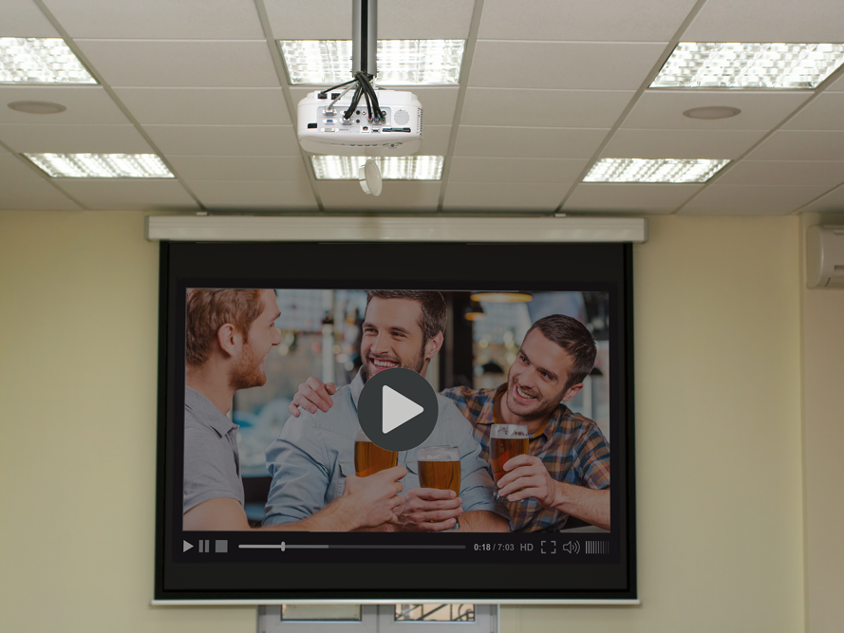
Overview
Notes:
A. OVerview
A live alcohol workshop is strongly recommended by NHTSA/IACP. The use of video-drinking subjects is an optional training method. The SFST course allows two video options in the core curriculum.
Video Option One is to use NHTSA/IACP-approved videos of drinking subjects used in SESSION 11-A, “TESTING SUBJECTS PRACTICE: FIRST SESSION” ONLY. This option will include a live alcohol workshop in Session 14.
Video Option Two uses NHTSA/IACP-approved videos of drinking subjects in SESSION 11-A, “TESTING SUBJECTS PRACTICE: FIRST SESSION, AND IN SESSION 14-A, “TESTING SUBJECTS PRACTICE: SECOND SESSION.
__________________________________________________________________________
__________________________________________________________________________
__________________________________________________________________________
__________________________________________________________________________
__________________________________________________________________________
__________________________________________________________________________

Slide 6

Procedures for Using Video
Notes:
B. Procedures for Using Videos
When using the videos in your course, divide the class into two groups. Participants should work in the same groups formed for the Dry Run Practice Session. The instructor should distribute video score sheets and have participants fill in their name.
Advise participants each subject will be viewed performing all three tests. Brief pauses occur between each test to allow participants time to record observed clues. Advise participants two views of the subject performing the Walk and Turn are also provided. The first is an overall view of both stages and the second is a close-up of the subject’s feet while walking.
It is recommended half the class practice the SFSTs under the direction of classroom instructors while the remainder of the class views, records, and interprets the NHTSA/IACP-approved videos for this session. Once completed, the groups switch roles. Only one instructor is needed to direct the viewing of the videos.
If time permits, participants will administer additional tests to each other. Participants will report their observations of video subjects at the end of the session. The instructors will notify participants of the video subjects’ BACs.
__________________________________________________________________________
__________________________________________________________________________
__________________________________________________________________________

Slide 7

SFST Log
Notes:
C. Use and Maintenance of the SFST Log
The SFST Log is used to record the results of the SFSTs performed on suspected impaired subjects. This log is extremely important in documenting an officer's experience and proficiency in performing and interpreting SFSTs.
This log has the following components:
The date the SFSTs were administered
Subject's full name
Results of each SFST test
Classification of BAC as above or below 0.08 BAC
Arrest/Not Arrest
Subject's measured BAC (if available)
Remarks
Utilization of the SFST Log
NHTSA and IACP strongly recommend each officer continue to document all administrations of SFSTs throughout their DWI enforcement career. The documentation will include subject's name, date, results of each test, and the officer's classification of subject's BAC and measured BAC, if available. A sample log is included.
__________________________________________________________________________
__________________________________________________________________________

Slide 8

Questions and/or Concerns
Notes:
D. QuestionS AND/OR CONCERNS
Solicit questions and comments from participants before moving to the next Session.
__________________________________________________________________________
__________________________________________________________________________
__________________________________________________________________________
__________________________________________________________________________
__________________________________________________________________________
__________________________________________________________________________
__________________________________________________________________________
__________________________________________________________________________
__________________________________________________________________________
__________________________________________________________________________
__________________________________________________________________________
__________________________________________________________________________

