Slide 1



DWI Detection & SFST
Instructor
Development
Course
Session 11 – Course Review, Examination, Evaluation, and Wrap-Up
February, 2017

Slide 2

Content Segments
Review
Final Exam
Closing Remarks
Course Completion Certificates
Course Evaluation
Questions
Notes:
Session 11: Course Review, Examination, Evaluation, and Wrap-Up
Estimated time for Session 11: 2 Hours, 30 Minutes (depending on class size)
Contents
Review
Final Exam
Closing Remarks
Course Completion Certificates
Course Evaluation
Questions
Materials
Presentation slides
DWI Detection and SFST Instructor Administrator Guide
Post test
Instructional Notes are presented in bold italic throughout the sessions.

Slide 3

DWI Detection and SFST
Instructor Development Course
Session 11:
Course Review, Examination, Evaluation, and Wrap-Up
Notes:
Session 11: Course Review, Examination, Evaluation, and Wrap up
Estimated time for Session 11: 2 Hours, 30 Minutes
Review: 1 hour, 30 Minutes
Examination: 30 Minutes
Evaluation and Wrap up: 30 Minutes
Materials:
Presentation slides
DWI Detection and SFST Instructor Administrator Guide
Post test
__________________________________________________________________________
__________________________________________________________________________
__________________________________________________________________________
__________________________________________________________________________
__________________________________________________________________________
__________________________________________________________________________
__________________________________________________________________________
__________________________________________________________________________

Slide 4

Notes:
A. Review
What is learning?
At its core, the learning process is about change. Learning is a natural process through which lasting physical changes are made to the human brain and nervous system resulting in new knowledge, skills, and attitudes.
__________________________________________________________________________
__________________________________________________________________________
__________________________________________________________________________
__________________________________________________________________________
__________________________________________________________________________
__________________________________________________________________________
__________________________________________________________________________
__________________________________________________________________________
__________________________________________________________________________
__________________________________________________________________________

Slide 5
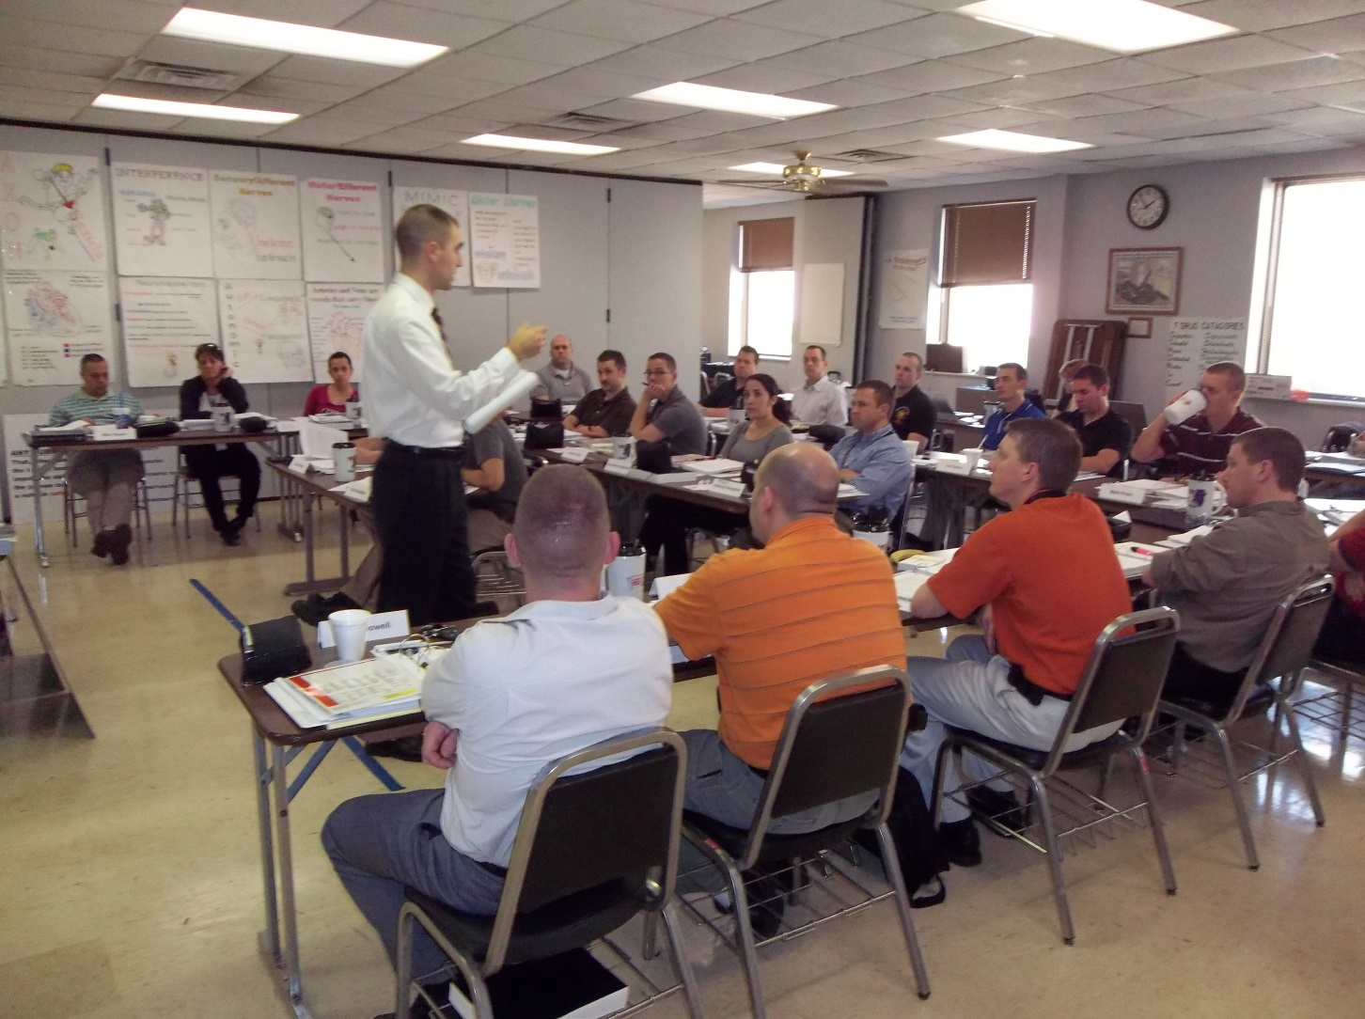
What is Instruction?
Notes:
What is instruction?
Definition: A conversational process engaged in by mutual consent by two or more agents for the purpose of promoting learning by one or both of the agents. (Gibbons, 2014)
__________________________________________________________________________
__________________________________________________________________________
__________________________________________________________________________
__________________________________________________________________________
__________________________________________________________________________
__________________________________________________________________________
__________________________________________________________________________
__________________________________________________________________________
__________________________________________________________________________
__________________________________________________________________________
__________________________________________________________________________

Slide 6

Cycle of Instruction
?
?
?
TASK / PROBLEM CENTERED
?
?
Notes:
Describe the Cycle of Instruction.
Problem-Centered Principle: Learning is promoted when learners acquire skill in the context of real-world problems
Activation Principle: Learning is promoted when learners recall existing knowledge and skill as a foundation for new skills
Demonstration Principle: Learning is promoted when learners are shown the skill to be learned
Application: Learning is promoted when learners use their newly-acquired skill to solve problems
Integration: Learning is promoted when learners reflect on, discuss, and defend their newly acquired skill
__________________________________________________________________________
__________________________________________________________________________
__________________________________________________________________________
__________________________________________________________________________
__________________________________________________________________________
__________________________________________________________________________
__________________________________________________________________________

Slide 7

Primacy
Notes:
Describe Primacy.
We recall what we hear first and last, but the middle is more readily forgotten.
Open and close each presentation with attention grabbers and your most important points.
Ask: how do you plan on applying Primacy in your presentations?
__________________________________________________________________________
__________________________________________________________________________
__________________________________________________________________________
__________________________________________________________________________
__________________________________________________________________________
__________________________________________________________________________
__________________________________________________________________________
__________________________________________________________________________
__________________________________________________________________________

Slide 8
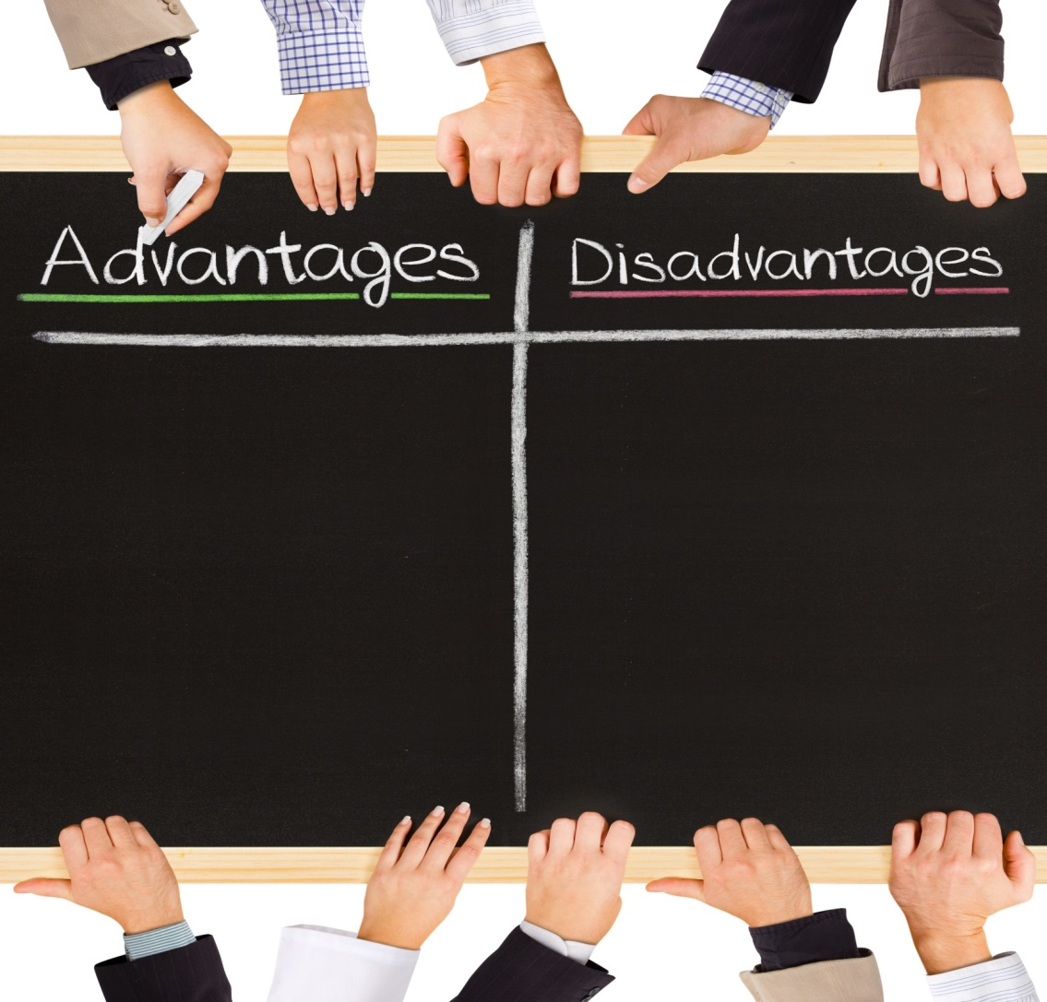
Team Teaching
Notes:
Describe the advantages and disadvantages of Team Teaching.
Advantages
The second instructor can serve as a secondary resource of subject matter knowledge
Two instructors can better assess participant reaction to course material
Shared workload
Disadvantages
Varying levels of authority or management within the organization
Varying levels of subject matter knowledge or training delivery experience
Individual differences in personality or training delivery
__________________________________________________________________________
__________________________________________________________________________
__________________________________________________________________________
__________________________________________________________________________
__________________________________________________________________________
__________________________________________________________________________
__________________________________________________________________________
__________________________________________________________________________

Slide 9

Administrator Guide
Notes:
What is the purpose of the Administrator Guide?
Describe the contents of the Administrator Guide.
Note: Have a copy of the complete DWI Detection and SFST Administrator Guide available for discussion.
The Administrator Guide is intended to provide an introduction to and an overview of the course.
__________________________________________________________________________
__________________________________________________________________________
__________________________________________________________________________
__________________________________________________________________________
__________________________________________________________________________
__________________________________________________________________________
__________________________________________________________________________
__________________________________________________________________________

Slide 10

Lesson Plan
Notes:
What are the purposes of the Lesson Plan?
Help you get ready to teach
To help you stay on track while you are teaching the lesson
Ensure consistency of training
__________________________________________________________________________
__________________________________________________________________________
__________________________________________________________________________
__________________________________________________________________________
__________________________________________________________________________
__________________________________________________________________________
__________________________________________________________________________
__________________________________________________________________________
__________________________________________________________________________
__________________________________________________________________________

Slide 11
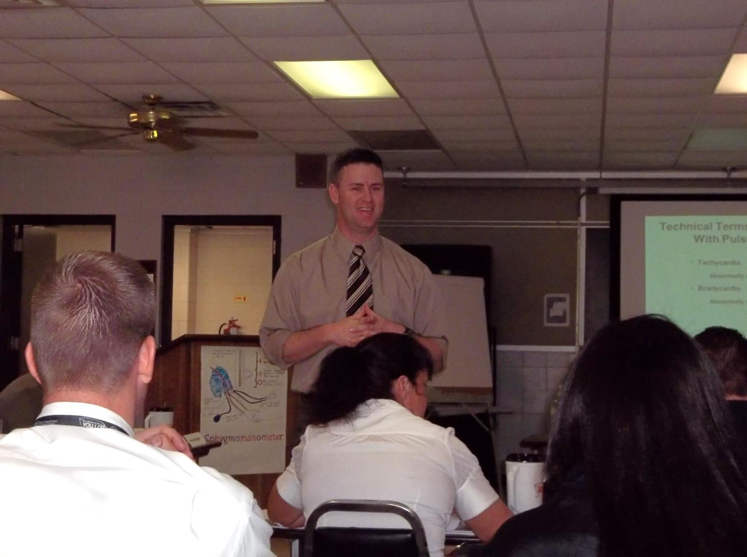
Qualities of a Good Instructor
Notes:
What are the qualities of a good instructor?
Basic qualities are required for a good DWI instructor:
The instructor must be able to present the tasks being taught
Instructor must be able to coach participants to perform the task correctly
The instructor must be able to evaluate the participants performing the tasks
__________________________________________________________________________
__________________________________________________________________________
__________________________________________________________________________
__________________________________________________________________________
__________________________________________________________________________
__________________________________________________________________________
__________________________________________________________________________
__________________________________________________________________________
__________________________________________________________________________
__________________________________________________________________________

Slide 12
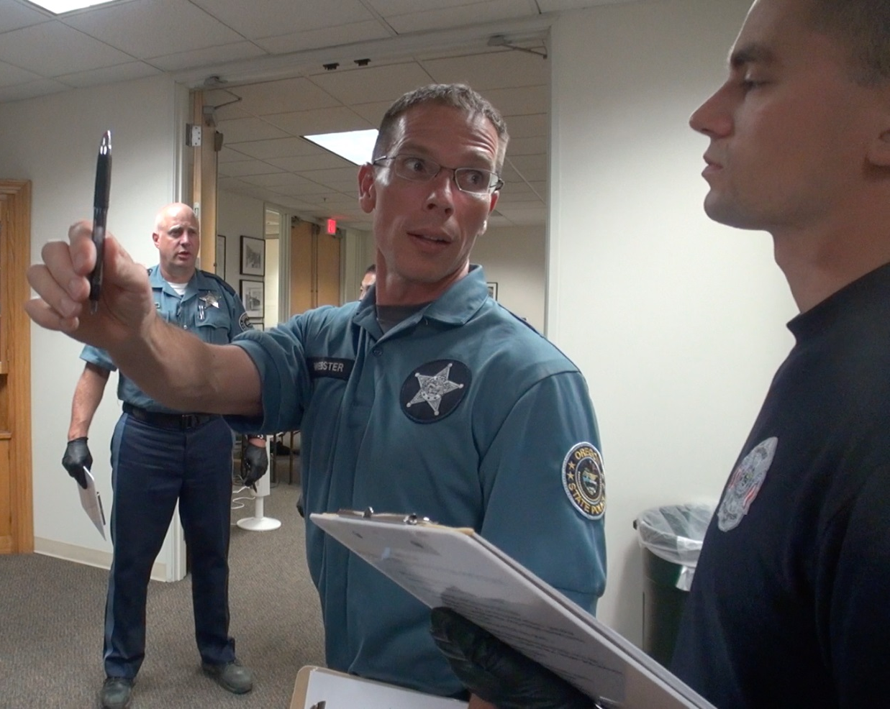
What is Feedback?
Notes:
What is feedback?
Feedback can be defined as any shared information that helps instructors and learners:
Understand how well they are performing their assigned roles or tasks in the conversation
Know what is needed to make progress towards the goal(s) of the conversation
Why is feedback important?
In general, feedback is important to:
Prompt the exchange of information
Generate or revise the shared purpose of the conversation
Facilitate engagement between people
Help people listen, think, and respond to one another until the shared purpose is achieved
__________________________________________________________________________
__________________________________________________________________________
__________________________________________________________________________
__________________________________________________________________________
__________________________________________________________________________
__________________________________________________________________________

Slide 13

Questioning Methods
Notes:
What are the three types of questions?
Ask the participants for examples of each.
Describe and review the questioning methods
Overhead/undirected
Pre-directed
Overhead/directed
__________________________________________________________________________
__________________________________________________________________________
__________________________________________________________________________
__________________________________________________________________________
__________________________________________________________________________
__________________________________________________________________________
__________________________________________________________________________
__________________________________________________________________________
__________________________________________________________________________

Slide 14

Participants’ Answers
Notes:
What should an instructor do when a participant gives a correct answer?
Review the following with the participants:
Commend participant
React with positive reinforcement
Don’t give bland acknowledgement
Don’t fail to give any reaction at all
What should an instructor do when a participant gives an incorrect answer?
Review the following with the participants:
Convey answer is incorrect
Do not react with frustration or anger
Do not embarrass the participant
Acknowledge partially correct answers
What should an instructor do if participants do not offer an answer?
Review the following with the participants:
Provide the answer yourself
Redirect the question to another learner
Defer the question
__________________________________________________________________________
__________________________________________________________________________

Slide 15
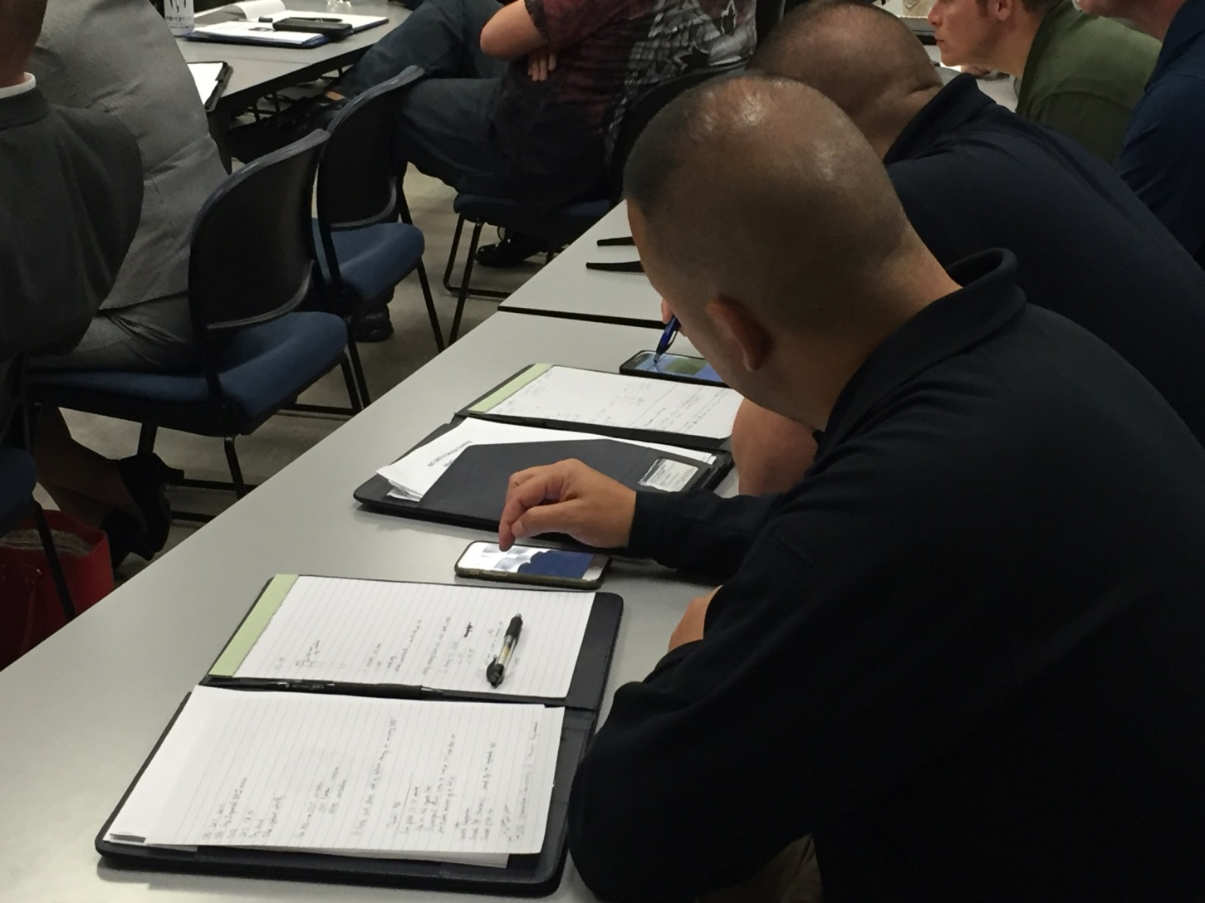
Problem Situations
Notes:
What are some key considerations for problem situations?
The key considerations to responding to problem situations created by participants are:
Eliminate or minimize the problem behavior
Maintain the participant’s self-esteem
Avoid further disruption to learning
Emphasize: Instructors should avoid harming a participant’s self-esteem; however, on rare occasions it may be more important to avoid further disruption to learning.
__________________________________________________________________________
__________________________________________________________________________
__________________________________________________________________________
__________________________________________________________________________
__________________________________________________________________________
__________________________________________________________________________
__________________________________________________________________________
__________________________________________________________________________

Slide 16
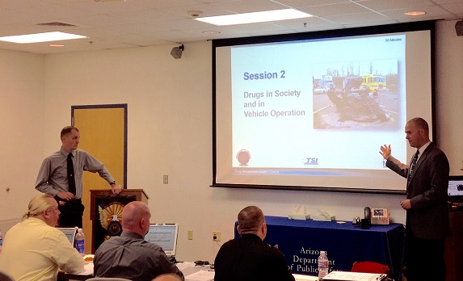
Notes:
What are commonly used training aids?
Prepared wall charts
Whiteboard or easel/easel pad
Audio/video
Presentation slides
Handouts
Props
__________________________________________________________________________
__________________________________________________________________________
__________________________________________________________________________
__________________________________________________________________________
__________________________________________________________________________
__________________________________________________________________________
__________________________________________________________________________
__________________________________________________________________________
__________________________________________________________________________

Slide 17
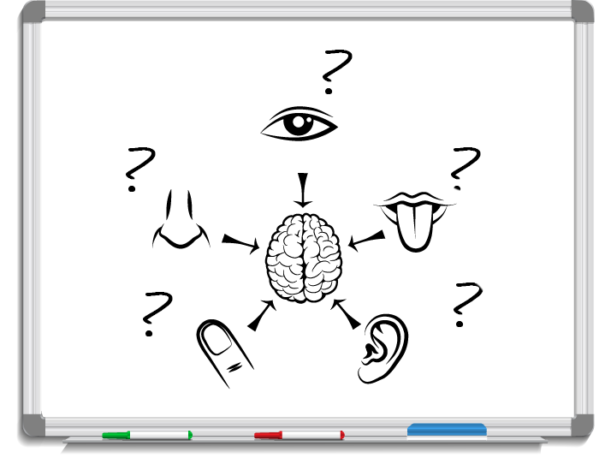
Purposes of Training Aids
Notes:
Describe the purposes of training aids?
Training aids are essential for effective instruction.
Training aids may appeal to multiple senses, including: sight, hearing, smell, taste, and touch
Training aids serve to emphasize key points and help to reinforce participants’ understanding and retention of the material covered
__________________________________________________________________________
__________________________________________________________________________
__________________________________________________________________________
__________________________________________________________________________
__________________________________________________________________________
__________________________________________________________________________
__________________________________________________________________________
__________________________________________________________________________
__________________________________________________________________________
__________________________________________________________________________

Slide 18

Advanced Planning Tasks
Notes:
Describe some of the considerations for planning an alcohol workshop.
Advanced planning should begin prior to the alcohol workshop.
Select the volunteer drinkers
Prepare the volunteers
Secure the supplies
Select and assign monitors for the volunteers
Select and assign bartenders
Select and arrange facilities for the volunteer drinkers
Arrange transportation for the volunteer drinkers
Arrange for breath testing
What are the quantity and qualifications for volunteer drinkers?
It is suggested there be one volunteer drinker for every three to five participants. They must be at least 21 years old and should be physically capable of performing the SFSTs. It is preferred police officers not be used as volunteer drinkers and is strongly recommended drinkers be alcohol and drug free.
__________________________________________________________________________
__________________________________________________________________________
__________________________________________________________________________
__________________________________________________________________________

Slide 19

Deterrence and DWI
Notes:
Deterrence and DWI
Approximately what percentage of fatal crashes involve drivers who have been drinking?
31%
On any typical weekend night, approximately what percentage of cars are driven by persons who are DWI?
10%
Approximately what percentage of adult Americans are estimated to commit DWI at least occasionally?
55%
About how many times per year does the average DWI violator commit DWI?
80
It is estimated the current odds of being arrested for DWI on any one impaired driving event are about one in ______.
78
__________________________________________________________________________
__________________________________________________________________________
__________________________________________________________________________
__________________________________________________________________________
__________________________________________________________________________
__________________________________________________________________________

Slide 20
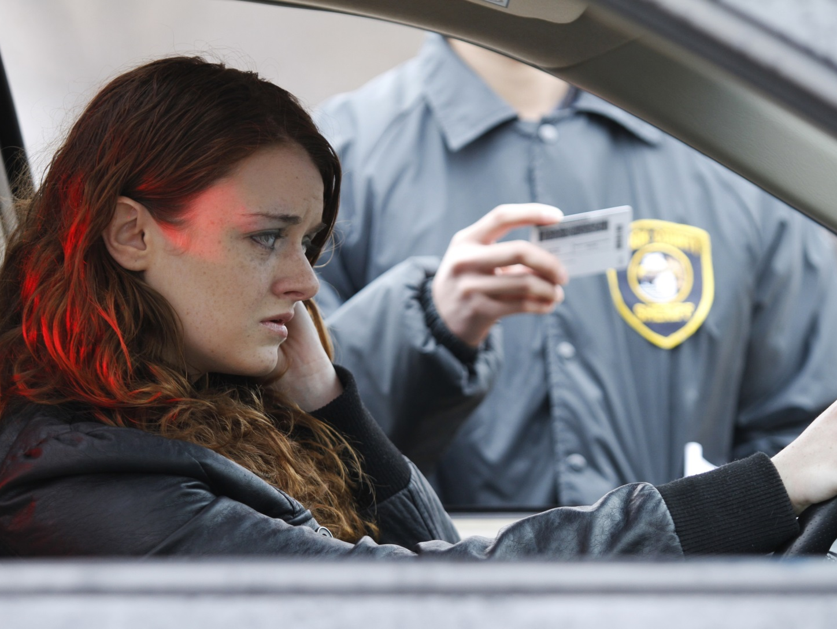
Detection Phases
Notes:
Detection Phases
What are the three phases of detection?
Vehicle in motion
Personal contact
Pre-arrest screening
What is the definition of “DWI Detection"?
The entire process of identifying and gathering evidence to determine if a subject should be arrested for a DWI violation
What is the police officer's principal decision during Detection Phase One?
Should I stop the vehicle?
During Phase Two?
Should I have the driver exit the vehicle?
During Phase Three?
Should I arrest the subject for DWI?
__________________________________________________________________________
__________________________________________________________________________
__________________________________________________________________________
__________________________________________________________________________
__________________________________________________________________________
__________________________________________________________________________

Slide 21

Laws
Notes:
Laws
What does "Per Se" mean?
In and of itself
The "illegal per se" law makes it an offense to operate a motor vehicle while______.
Having a statutorily prohibited BAC level
True or False: A person cannot be convicted of DWI if BAC was below 0.05.
False
__________________________________________________________________________
__________________________________________________________________________
__________________________________________________________________________
__________________________________________________________________________
__________________________________________________________________________
__________________________________________________________________________
__________________________________________________________________________
__________________________________________________________________________
__________________________________________________________________________

Slide 22

Alcohol Physiology
Notes:
Alcohol Physiology
True or False: Vision will be impaired for virtually all people by the time BAC reaches 0.08.
True
Where is the majority of alcohol absorbed?
Small intestine
__________________________________________________________________________
__________________________________________________________________________
__________________________________________________________________________
__________________________________________________________________________
__________________________________________________________________________
__________________________________________________________________________
__________________________________________________________________________
__________________________________________________________________________
__________________________________________________________________________
__________________________________________________________________________

Slide 23
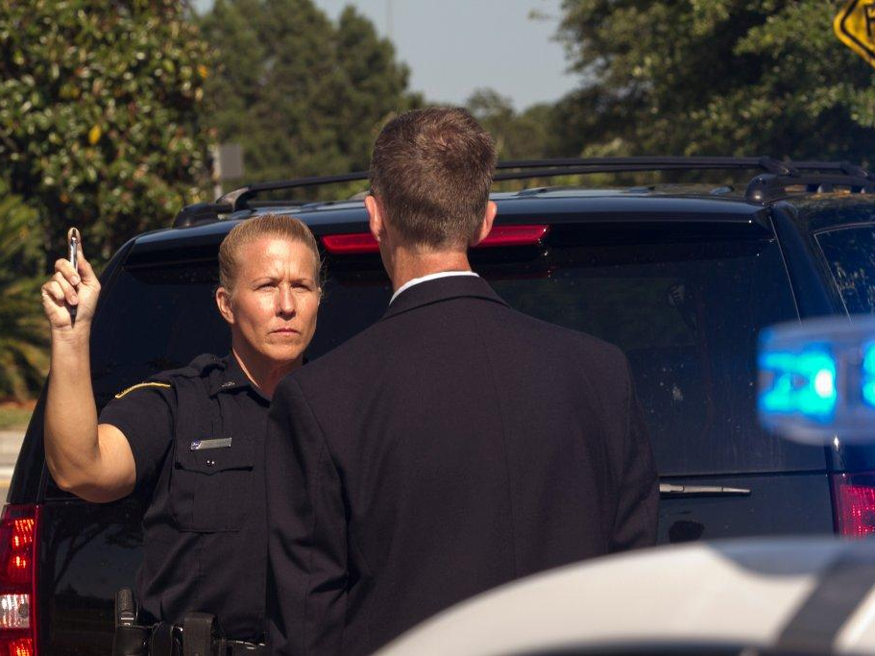
SFSTs
Notes:
SFSTs
What does "nystagmus" mean? Involuntary jerking of the eyes
Walk and Turn is an example of a ___Divided_______ attention test.
Name the eight distinct clues of Walk and Turn.
Cannot keep balance while listening to instruction
Starts too soon
Stops while walking
Does not touch heel-to-toe
Steps off the line
Uses arms to balance
Improper turn
Incorrect number of steps
Name the four distinct clues of One Leg Stand.
Sways while balancing
Uses arms to balance
Hopping
Puts foot down
Name the three distinct clues of Horizontal Gaze Nystagmus.
Lack of smooth pursuit
Distinct and sustained nystagmus at maximum deviation
Onset of nystagmus prior to 45 degrees
How many steps in each direction must the subject take in the Walk and Turn test? 9
How long must the subject stand on one foot in the One Leg Stand test? 30 seconds
Suppose a subject produces two clues on the HGN test and no clues on the Walk and Turn test. Should you classify the subject's BAC as above or below 0.08? No
How reliable is each test?
HGN: 88%
WAT: 79%
OLS: 83%

Slide 24

Final Examination
Notes:
B. Final Exam
Distribute. Allow 30 minutes for completion. Passing grade is 80%.
If time allows, go over and review the final exam with the participants.
__________________________________________________________________________
__________________________________________________________________________
__________________________________________________________________________
__________________________________________________________________________
__________________________________________________________________________
__________________________________________________________________________
__________________________________________________________________________
__________________________________________________________________________
__________________________________________________________________________
__________________________________________________________________________

Slide 25
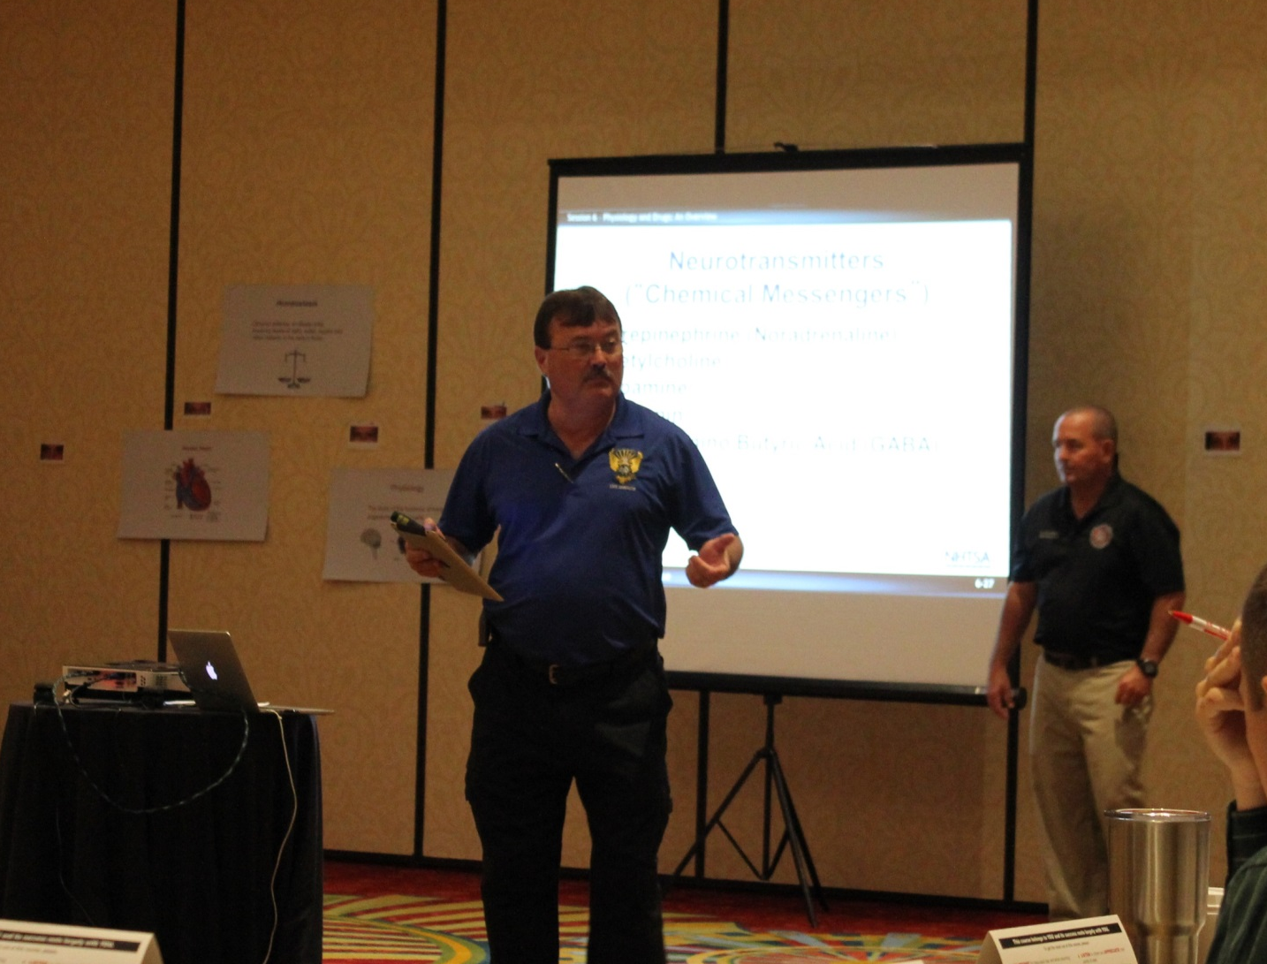
Closing Remarks
Notes:
C. Closing Remarks
D. Course Completion Certificates
Hand out completion certificates or other appropriate documentation.
__________________________________________________________________________
__________________________________________________________________________
__________________________________________________________________________
__________________________________________________________________________
__________________________________________________________________________
__________________________________________________________________________
__________________________________________________________________________
__________________________________________________________________________
__________________________________________________________________________
__________________________________________________________________________
__________________________________________________________________________

Slide 26

Course Evaluation
Notes:
E. Course Evaluation
Distribute evaluation forms and request the participants be honest in providing their input. If they feel the course can be improved, solicit their recommendations for improvement.
Distribute critique forms and then collect them.
__________________________________________________________________________
__________________________________________________________________________
__________________________________________________________________________
__________________________________________________________________________
__________________________________________________________________________
__________________________________________________________________________
__________________________________________________________________________
__________________________________________________________________________
__________________________________________________________________________
__________________________________________________________________________

Slide 27

Questions and/or Concerns
Notes:
F. QuestionS AND/OR CONCERNS
Allow for participants to ask any final questions.
__________________________________________________________________________
__________________________________________________________________________
__________________________________________________________________________
__________________________________________________________________________
__________________________________________________________________________
__________________________________________________________________________
__________________________________________________________________________
__________________________________________________________________________
__________________________________________________________________________
__________________________________________________________________________
__________________________________________________________________________
__________________________________________________________________________

