Slide 1



DWI Detection & SFST
Instructor
Development
Course
Session 5 – Effective Feedback, Coaching,
and Proficiencies
February, 2017

Slide 2

Content Segments
Feedback From Previous Training
The Purposes of Effective Feedback
Strategies for Providing Effective Feedback
Feedback on the Job
Feedback in Instructional Settings
The Three Feedback Questions
The Feedback “Sandwich Recipe”
Praise or Feedback
Integrating the Effective Feedback Recipe
Summary and Example
Questions and/or Concerns
Notes:
Session 5: Effective Feedback, Coaching, and Proficiencies
Estimated time for Session 5: 2 Hours (depending on class size)
Session Objectives
Identify the skills necessary to provide effective feedback
Demonstrate an effective feedback method
Apply the effective feedback method using the scenarios provided
Use effective feedback method during final presentations
Conduct SFST proficiency examination
Contents
Feedback From Previous Training
The Purposes of Effective Feedback
Strategies for Providing Effective Feedback
Feedback on the Job
Feedback in Instructional Settings
The Three Feedback Questions
The Feedback “Sandwich Recipe”
Praise or Feedback
Integrating the Effective Feedback Recipe
Summary and Example
Questions and/or Concerns
Materials
Presentation slides
Easel/Easel Pad
Markers
SFST Proficiency Forms
Computer speakers (for embedded videos)
Instructional Notes are presented in bold italic throughout the sessions.

Slide 3

DWI Detection and SFST
Instructor Development Course
Session 5:
Effective Feedback, Coaching,
and Proficiencies
Notes:
Session 5: Effective Feedback, Coaching, and Proficiencies
Estimated time for Session 5: 2 Hours
Materials
Presentation slides
Easel/Easel Pad
Markers
SFST Proficiency Examination Forms
Computer speakers (for embedded audio)
Explain to participants the session will focus on providing feedback while supervising SFST proficiencies as required during the SFST Course. Although there are many other skills requiring feedback and coaching, this will serve as an example of general process.
__________________________________________________________________________
__________________________________________________________________________
__________________________________________________________________________
__________________________________________________________________________
__________________________________________________________________________
__________________________________________________________________________

Slide 4

Session Objectives
Provide effective feedback
Demonstrate an effective feedback method
Apply effective feedback method using scenarios
Use effective feedback method during final presentations
Conduct SFST proficiency examination
Notes:
Session Objectives
At the conclusion of this session, participants should be able to:
Identify the skills necessary to provide effective feedback (Activation)
Demonstrate an effective feedback method (Demonstration)
Apply the effective feedback method using the scenarios provided (Application)
Use effective feedback method during final presentations (Integration)
Conduct SFST proficiency examination
__________________________________________________________________________
__________________________________________________________________________
__________________________________________________________________________
__________________________________________________________________________
__________________________________________________________________________
__________________________________________________________________________
__________________________________________________________________________
__________________________________________________________________________
__________________________________________________________________________

Slide 5

Feedback From Previous Training
Was it helpful
How did it make you feel
Did you believe it helped you to better perform the task
Did your skills improve as a result
Did it motivate you
Notes:
A. FeedbAck from Previous Training
Use the activation principle to discuss prior critiquing/feedback experience the participants have encountered.
Recall previous training you have attended in which an instructor provided feedback. What about this feedback was positive, negative, or memorable.
Instructor should record answers to the following questions on a easel/easel pad. Discuss the following questions:
Was it helpful?
How did it make you feel?
Did you believe it helped you to better perform the task?
Did your skills improve as a result?
Did it motivate you?
Ask the participants:
Would anyone share an experience about receiving feedback?
Why is feedback important?
Ask participants to close their manuals.
__________________________________________________________________________
__________________________________________________________________________

Slide 6
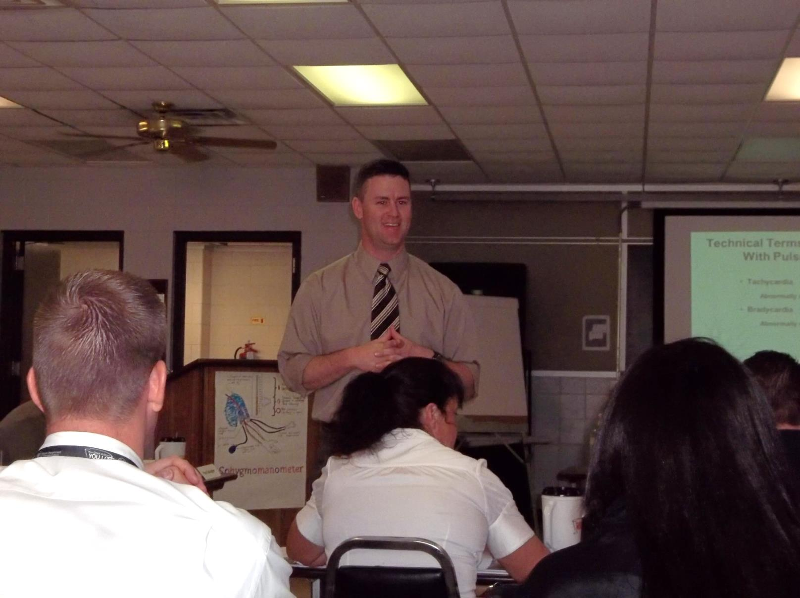
Qualities of a Good Instructor
Notes:
Qualities of a Good Instructor
Remind participants to keep their books closed during this activity.
What does it take to be a good instructor?
Small Group Activity:
Assign participants to groups of four to six. Each group should come up with 4-5 answers to the above question. Groups will take turns naming good qualities.
During discussion instructor should try to elicit the following qualities.
Basic qualities are required for a good DWI instructor:
The instructor must be able to present the tasks being taught
The instructor must be able to coach participants to perform the task correctly
The instructor must be able to evaluate the participants performing the tasks
__________________________________________________________________________
__________________________________________________________________________
__________________________________________________________________________
__________________________________________________________________________
__________________________________________________________________________

Slide 7

Notes:
If the DWI instructor cannot PERFORM the tasks assigned to teach, the instructor will have difficulty.
How can you PRESENT a task to the participant if you can’t perform it yourself?
How can you COACH a participant while the participant practices the task if you can’t perform the task yourself?
Instructors should encourage participants during practice. If you can’t actually perform the task it will be very difficult to offer effective feedback.
Coaching skills:
Ability to offer feedback
Ability to deliver positive reinforcement
How can you EVALUATE the participant if you don’t know the correct way to perform the task?
__________________________________________________________________________
__________________________________________________________________________
__________________________________________________________________________
__________________________________________________________________________
__________________________________________________________________________

Slide 8

The Power of Feedback
Ability to
Learn
+31%
Performance
+26%
Notes:
The instructor should summarize the Activation exercise by asking the questions below. These questions are meant to gain attention and not to solicit answers from the participants.
Would you be interested in improving your performance by 26 percent?
What if I could further improve your ability to learn by 31 percent?
Are you interested?
Our brains learn best when we get the right feedback, at the right time, to point us in the right direction
__________________________________________________________________________
__________________________________________________________________________
__________________________________________________________________________
__________________________________________________________________________
__________________________________________________________________________
__________________________________________________________________________
__________________________________________________________________________
__________________________________________________________________________
__________________________________________________________________________

Slide 9

Effectiveness of Feedback
Effectiveness of Feedback
Have no
Impact on
Performance
Make
Performance
Worse
Have Positive
Impact on
Performance
Notes:
Not all feedback is created equal. A 1998 study (Najjar, 1998) revealed approximately one-third of all feedback strategies used in the workplace makes our performance worse! Another one-third of the feedback strategies have no impact at all. This leaves one-third of the feedback strategies which can actually make a difference.
Instructor should emphasize two-thirds of feedback messages have either no impact or make performance worse.
What is the key? In order to improve performance, the feedback needs to focus on giving people information that helps them see how well they are progressing towards a goal.
__________________________________________________________________________
__________________________________________________________________________
__________________________________________________________________________
__________________________________________________________________________
__________________________________________________________________________
__________________________________________________________________________
__________________________________________________________________________
__________________________________________________________________________

Slide 10
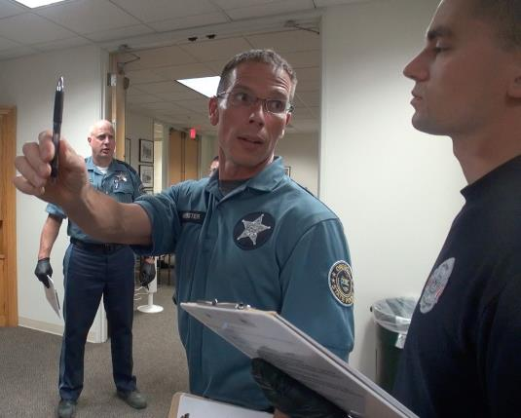
Feedback is Part of the
Learning Conversation
Notes:
B. The Purposes of Effective Feedback
Summarize the purpose of effective feedback and tie in how feedback is an important part of an instructional conversation, which was defined in Session 2.
The most powerful and comprehensive metaphor we can use to design instruction is the metaphor of a conversation. There are four key characteristics of a conversation:
Information Exchange: Information is exchanged between people
Shared Purpose: There is a shared purpose to the exchange of information
Engaging: Everyone intends to engage one another in the conversation
Listening: Everyone is willing to listen and think before responding
__________________________________________________________________________
__________________________________________________________________________
__________________________________________________________________________
__________________________________________________________________________
__________________________________________________________________________
__________________________________________________________________________
__________________________________________________________________________

Slide 11
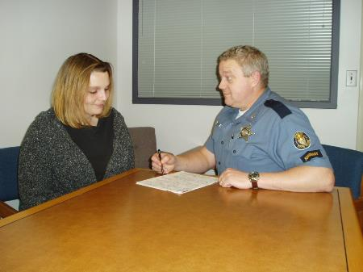
Definition of Feedback
Shared information that helps instructors and participants:
Understand how well they are performing their assigned roles or tasks in the conversation
AND
Know what is needed to make progress towards the goal(s) of the conversation
Notes:
Feedback can be defined as any shared information that helps instructors and participants:
Understand how well they are performing their assigned roles or tasks in the conversation
Know what is needed to make progress towards the goal(s) of the conversation
In general, feedback will be exchanged to:
Prompt the exchange of information
Generate or revise the shared purpose of the conversation
Facilitate engagement between people
Help people listen, think, and respond to one another until the shared purpose is achieved
__________________________________________________________________________
__________________________________________________________________________
__________________________________________________________________________
__________________________________________________________________________
__________________________________________________________________________
__________________________________________________________________________
__________________________________________________________________________

Slide 12
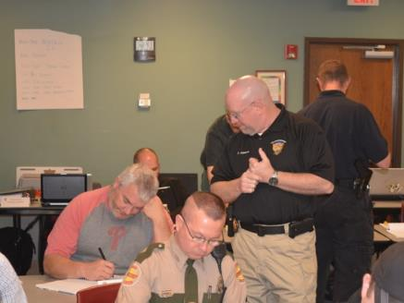
Instructor’s Feedback
Learning goals or objectives were achieved
Improve skills in listening, thinking, and responding
Take an active role
Notes:
In an instructional conversation, the shared purpose is usually to help the participant acquire new knowledge, skills, or attitudes. This shared purpose is sometimes defined ahead of time in the form of written objectives. However, as an instructional conversation evolves, new unwritten learning goals may emerge.
In general, the four key characteristics will occur within a conversational pattern that consists of three distinct stages—a beginning, a middle, and an end—with each stage supporting a dramatic structure much like that of an engaging story. The type of feedback that is exchanged between instructors and participants will often depend on the stage of the conversation.
Instructors and participants should work together to bring the conversation to a satisfactory conclusion.
The instructor’s feedback should encourage participants to:
Reflect on how well they achieved the learning goals or objectives
Help them consider ways to improve their skills in listening, thinking, and responding to information
Take an active role in carrying out the interrelated activities in the various stages of the conversation
__________________________________________________________________________
__________________________________________________________________________
__________________________________________________________________________

Slide 13

Participant Feedback
Determine effectiveness of the conversation
Identify ways to improve future conversations
Increase participant skills
Notes:
In return, the participants’ feedback should help the instructor:
Determine how effective and efficient the strategy was in achieving the purpose of the conversation
Identify ways to improve future conversations to make them more effective, efficient, and appealing to the participants
Increase participant skills in listening, thinking, and responding to information that is exchanged during the conversation
Now that you have been introduced to the purposes of feedback during the three stages of an instructional conversation, you are now ready to consider some strategies for generating effective feedback messages.
__________________________________________________________________________
__________________________________________________________________________
__________________________________________________________________________
__________________________________________________________________________
__________________________________________________________________________
__________________________________________________________________________
__________________________________________________________________________

Slide 14
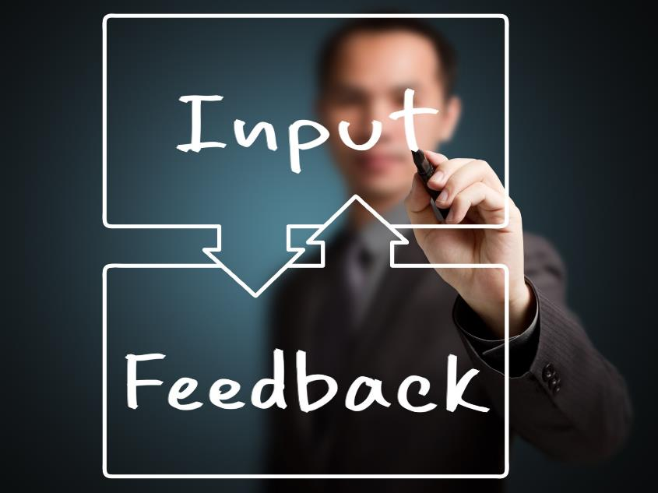
Notes:
C. Strategies for Providing Effective Feedback
Instructor should record responses to the following question on a easel/easel pad.
Utilizing the Activation principle: Ask the participants “where else have you or could you utilize effective feedback in your professional and personal life?”
Lead the participants in a discussion on the feedback involved in learning to drive a vehicle. Example: Feedback started early in life from observing your parents driving a car. This continued to when you began to drive. The feedback can have a negative impact, for instance if your parent yells in reaction to your performance behind the wheel. Feedback can involve self-evaluation while reacting to hazardous road conditions for the first time.
Conclude this instructional conversation with a reminder that feedback is found in learning everyday skills like driving and in an instructional setting. We are going to demonstrate an effective method.
In this course, we are concerned with feedback that occurs in the classroom. If we know what type of feedback participants might encounter, we can design our instructional conversations to include similar types of feedback. This will help participants practice receiving feedback and using it to succeed in their instructing and training. We will now briefly explore different types of feedback.
__________________________________________________________________________
__________________________________________________________________________

Slide 15
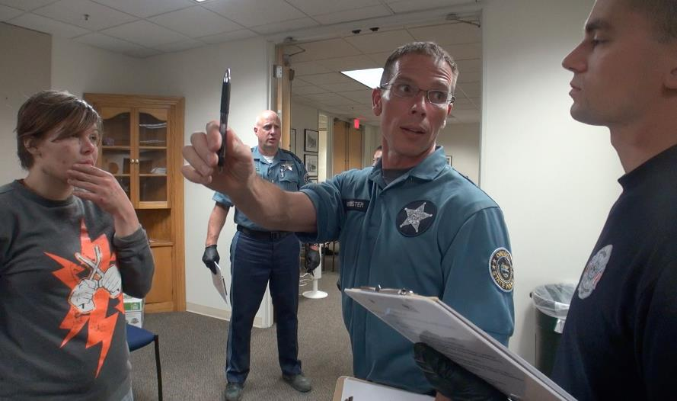
Feedback on the Job
Notes:
D. Feedback on the Job
One powerful way to improve job performance is to provide people with feedback on one or more field tasks. This feedback can come from supervisors, fellow officers, citizens, or anyone else in the field. Research has found about one-third of all feedback strategies resulted in improved performance. This confirms the usefulness of feedback in helping people learn new knowledge and skills. However, research also revealed one-third of the feedback strategies had no effect at all and one-third of the strategies actually reduced performance. The feedback made them less effective and efficient in their work tasks. Clearly, not all feedback is equal. But what is the difference between feedback that improves task performance and feedback that makes it worse?
When feedback is focused on clear goals and current performance of the work tasks, it can have a positive effect. Helpful feedback will show people how to change what they are currently doing to reach their goals. Feedback will have no effect or a negative effect when it focuses on the person instead of the task. Also, feedback decreases performance when it is used to blame people or hold them responsible for reaching unclear goals. That type of feedback can decrease motivation very quickly and focus people’s attention on defending themselves against unfair treatment instead of focusing on the work task and figuring out how to complete it.
Feedback provides information about current performance on a particular task and tells them how to do the task more effectively. The instructor should build on the driving example:
Vehicle braking in response to a situation :
“I want to talk to you about how you applied the brakes.”
“What I saw was you slammed on the brakes instead of stopping gradually which caused you to almost get into a rear-end collision.”
“Try practicing easing on the brakes to slow down more gradually and under control and see if that works for you.”
“If it does, practice doing it ten more times so you get really good at it and I will check back with you next week.”

Slide 16

Instructional Feedback
Notes:
E. Feedback In Instructional Settings
In educational settings feedback has the greatest impact when it:
Provides information to participants about their current performance on a particular task
Tells them how to do the task more effectively
Feedback is more effective when it focuses on how to do a specific task correctly instead of emphasizing mistakes or incorrect responses. Also, feedback has a greater effect when it points out how participants have progressed from previous attempts at performing a challenging task. That way, the participants can see they are progressing. In addition, feedback is more effective if it directs participants to close the gap between their current performance and the end goal by doing one or more of the following:
Increase the amount of effort to tackle more challenging tasks
Develop error-detection skills which leads to better self-feedback
Look for better strategies or information that will help in performing the task
On the other hand, feedback that is used to provide praise, rewards, or punishment does not have as great an impact on performance. Also, feedback is less productive if it leads participants to do any of the following:
Stop working toward the goal
Set a less challenging goal
Combine the goal with many other goals. Later on, participants may only focus on the goals that are easily achieved and ignore the others
Accept lower quality performance as a satisfactory completion of the goal
Several things can be done to generate effective feedback messages that lead to increased learning and performance.

Slide 17

Feedback Questions
Notes:
F. The Three Feedback Questions
Instructor should write all three feedback questions on a easel/easel pad which can remain on display for the remainder of the training.
Instructor should use the previous vehicle braking illustration to explain the three questions.
Remind participants that a more in depth explanation of each of the three questions is included in their materials.
Effective feedback helps participants answer three important questions.
Question 1: Where am I going? (What are the goals?)
Question 2: How am I doing? (What progress is being made toward the goal?)
Question 3: Where to next? (What activities need to be undertaken to make better progress?)
Obviously, this is not the only kind of information instructors may provide in a feedback message. However, instructors will have the greatest impact on participant achievement if the feedback message helps participants answer one or more of these three questions. We will now explore recommendations for helping participants answer these questions.

Slide 18

Where am I going?
Notes:
Question 1: Where am I going? (What are the goals?)
Participants should be informed of the goals of a learning activity and the specific criteria that must be met to know when the goals have been achieved. In addition, participants should be informed about how challenging the goals are. It turns out if the participants are not challenged by the goals then feedback is of little value. It can only confirm what the participants already perceive-- they have the knowledge and skills and the goal is too easy for them to really learn anything from it. Participants also need to know the level of commitment required to achieve the goals. In particular, it can be helpful for them to know how much mental effort it will require and how much time they can expect to spend working toward the goal.
Much of the information related to the question "Where am I going?" may be provided to participants during the beginning stage of an instructional conversation. An instructional conversation always has a purpose or goal. For example, the goal of the DWI/SFST course is to prepare participants to better investigate DWI incidents. If participants don't know what the goal is, they will have a difficult time participating in the conversation. However, even after the beginning of the conversation, participants will still need reminders from time to time to keep the learning targets clear. When an instructional conversation begins to stray off course, it can be very helpful to review the original goals of the conversation and renew the commitment of everyone to remain engaged in the conversation.
__________________________________________________________________________
__________________________________________________________________________
__________________________________________________________________________

Slide 19

How am I doing?
Notes:
Question 2: How am I doing? (What progress is being made toward the goal?)
Participants should receive feedback regarding their own progress toward the goal as defined by completion of specific success criteria, not by comparing their own progress with that of others. In addition, progress feedback can also be related to expected standards, prior performance, and participant success or failure on a specific task.
The question of what progress is being made occurs during the middle stage of the conversation. That is when both instructors and participants are expected to measure/assess progress toward the goal(s) of the conversation. For example, during the first alcohol workshop, formative feedback is given to the participants on how they are meeting the learning goals. If it is determined the participants are using inappropriate procedures administering the SFSTs, they can make appropriate adjustments based on feedback.
__________________________________________________________________________
__________________________________________________________________________
__________________________________________________________________________
__________________________________________________________________________
__________________________________________________________________________
__________________________________________________________________________

Slide 20

Where to next?
Notes:
Question 3: Where to next? (What activities need to be undertaken to make better progress?)
“Where to next?” is the question participants are interested in the most. When instructors provide feedback related to this question, the information should not only tell participants what activities they should do next, but it should also help them generate their own answers to this question. Over time, participants will acquire the skills of self-regulation so they can answer this question on their own.
The ease with which the answers to this question can be generated will depend upon how well the knowledge, skills, and attitudes are used. Only after measuring/assessing participant performance can there be an overall evaluation and adjustment of the knowledge, skills, and attitudes.
Hopefully, the information above has given you a good understanding of what the three feedback questions are and why you need to ask them. In some situations, you will want to provide the answers to the questions, as the participants may not be able to answer it on their own. But if you are engaged in an extended instructional conversation, you will want to eventually involve the participant in answering these questions about their own performance. They need to learn to produce self-feedback to guide their own study and practice.
With the above information in mind, you are prepared to learn about a kind of “recipe” that you can follow to provide effective feedback to participants during the middle stage of the instructional conversation. We will refer to this recipe as the “Feedback Sandwich.”
Use the following slides to introduce the concept of the Feedback Sandwich.

Slide 21





The “Feedback Sandwich” Recipe
Notes:
G. The “Feedback Sandwich” Recipe
If the only feedback people receive is criticism, it may increase their performance in the short term, but it is not likely to be effective in the long run. Constant criticism can produce depression and other negative emotions that will eventually decrease motivation.
Feedback messages need sequenced layers of information to be effective.
Two instructors should demonstrate an effective Feedback Sandwich from a previous Cycle of Instruction activity. Another option would be to do another demonstration activity.
__________________________________________________________________________
__________________________________________________________________________
__________________________________________________________________________
__________________________________________________________________________
__________________________________________________________________________
__________________________________________________________________________

Slide 22



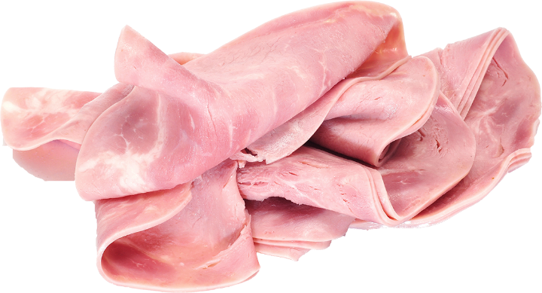

The “Feedback Sandwich” Recipe
Layer 1: Invitation
Layer 2: Success Message OR Challenge
Message
Layer 3: Motivation Check
Layer 4: Follow-Up
Notes:
__________________________________________________________________________
__________________________________________________________________________
__________________________________________________________________________
__________________________________________________________________________
__________________________________________________________________________
__________________________________________________________________________
__________________________________________________________________________
__________________________________________________________________________
__________________________________________________________________________
__________________________________________________________________________
__________________________________________________________________________
__________________________________________________________________________
__________________________________________________________________________
__________________________________________________________________________

Slide 23
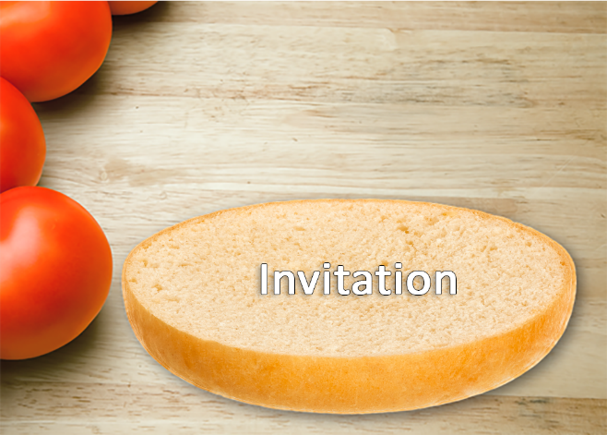
Layer 1: Invitation
Notes:
Layer 1: Invitation
The first layer of the Feedback Sandwich is an invitation to the participant to receive the feedback message. The purpose of the invitation is to find out if the participant is ready to receive the feedback and act upon it. If the invitation is accepted, you may proceed to add the next layer of information. If the invitation is not accepted, you should evaluate the conversation and make adjustments. You will need to create the conditions in which the participant is willing to hear and respond to the feedback. Otherwise, the participant may ignore the information and you will be wasting your time.
In the DWI/SFST course, it is usually understood there is an open invitation from the participant for the instructor to provide feedback at any time. Consequently, it may not be necessary for the instructor to extend an invitation before each feedback message. However, before the first feedback message is delivered, it is a good idea for the instructor to discuss the nature of the feedback messages the participants will receive. Participants don't always know what to do with a feedback message, so it is up to the instructor to show them how to use the information to make progress toward the goals of the conversation. Once the participant is prepared to receive the feedback message, the instructor can proceed to the next layer of the feedback message.
__________________________________________________________________________
__________________________________________________________________________
__________________________________________________________________________

Slide 24

Layer 2: Success Message or Challenge Message
Notes:
Layer 2: Success Message OR Challenge Message
Point out that a Success Message is different from praise. While praise may be a positive description of performance, Success Message includes acknowledgement of completion of goal or task in conjunction with participant’s perception of accomplishment. For example:
Praise: “You did a good job with the instructions on the Walk and Turn.”
Success Message: “I noticed that your covered all the points on the instructional stage. What did you do differently this time as opposed to earlier?”
If the participant has met the success criteria and achieved the goal, you will want to provide a Success Message that reinforces the learning and prepares the participant to accept a new instructional goal. If the participant has not met the success criteria, you should provide a Challenge Message that challenges the participant to develop new knowledge or improve their performance in some way. The type of information you provide in either the Success Message or the Challenge Message will depend on the type of instructional strategy you are using to teach facts, concepts, procedures, processes, or principles. In general, both the Success Message and the Challenge Message will help answer one or more of the three feedback messages:
Question 1: Where am I going? (What are the goals?)
Question 2: How am I doing? (What progress is being made toward the goal?)
Question 3: Where to next? (What activities need to be undertaken to make better progress?)
Stress the following point.
The Success Message or Challenge Message should NOT include praise or personal information about the participant. That information may be included in a follow-up message given to the participant at a later time, but praise should not be integrated into this part of the message. This is because it will dilute the effectiveness of the Success Message or Challenge Message.
The main goal with this layer is to make sure the participant knows what the goal is, how much progress they've already made toward it, and what else they need to do to reach it. Once you have delivered the Success Message or Challenge Message, you are ready to proceed to the next layer.

Slide 25
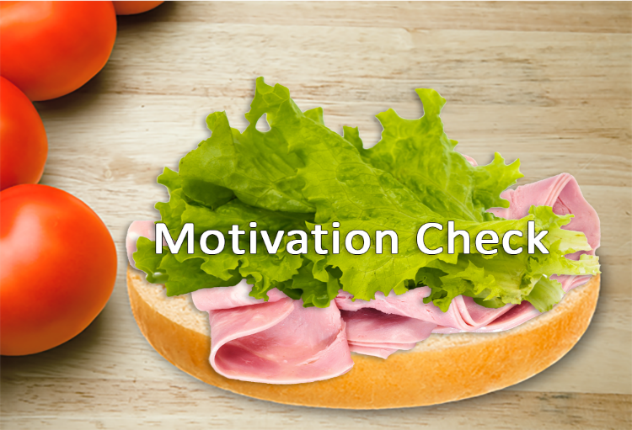
Layer 3: Motivation Check
Notes:
Layer 3: Motivation Check
Participants may have enough prior knowledge and skill to pursue an instructional goal, but if they lack sufficient motivation, they will never achieve it. There are three things that lead to motivated performance of a work task:
Commit to actively pursue the task (do it now, not later)
Persist at the task even when there are distractions
Invest the mental effort needed to succeed at the task
The purpose of the Motivation Check is to ensure participants will do all three of these things. However, instructors should know that before participants can do these three things, they must have certain beliefs about themselves and the task at hand.
They must have the self-confidence (attitude) to conduct a DWI investigation
They must also believe they have the knowledge and skills to conduct the investigation
They have the authority to conduct the investigation
If the any of the three are missing they are unlikely to conduct the investigation.
If the instructor believes there is a motivational barrier to do the task, but isn't sure what the nature of that barrier is, one or more of the following questions may be asked to pinpoint the problem.
How confident are you that you will be able to conduct DWI investigations?
What is your level of commitment to study and practice?
How will you persist at your practice activities even when distractions occur?
Do you believe you have access to all of the resources you need to achieve the goal?
Are you willing to invest enough mental effort to achieve the goal by the end of the course?
Depending on the answers to these questions, the instructor should provide the information needed to overcome any motivational barriers. Once it is clear the participant is motivated to do the work, the instructor can add the final layer of the Feedback Sandwich.

Slide 26





Layer 4: Follow-Up
Follow-Up
Invitation
Notes:
Layer 4: Follow-Up
The final layer of the Feedback Sandwich is to provide the participant with a brief explanation of a follow-up activity that will be done to ensure the participant is progressing toward the goal. If the participant knows progress is being measured and recorded, the task is much more likely to be completed. The follow-up message should include information that answers the following questions:
How will your progress be measured?
Who will do the measuring?
When will progress be measured?
(Optional) When will the next feedback message be given?
The last piece of information is optional because the timing of the message may depend upon a number of factors. However, if participants know when they will receive the next feedback message, they can better prepare themselves to receive it.
__________________________________________________________________________
__________________________________________________________________________
__________________________________________________________________________
__________________________________________________________________________
__________________________________________________________________________

Slide 27

Praise or Feedback
Notes:
H. Praise or Feedback
The timing of the praise or feedback is an important consideration. You should make sure the praise message isn't delivered directly before or after any Success Message or Challenge Message. You don't want to risk distracting the participants from their work by praise or personal information.
As part of the follow-up activities to an instructional conversation, the instructor may use brief praise or feedback about the participant’s performance. This may help to promote positive emotions and attitudes about learning and help participants take an active part in the instructional conversation. This feedback should be separate from the above feedback messages related to goal achievement. Feedback may do one or more of the following:
Help the participant acquire a sense of "belonging" to the group
Increase the level of trust between the instructor and participant
Increase the level of trust between the participant and other participants
Help the participant feel their work is appreciated
Let the participant know they are respected
Express a sense of optimism and confidence the participants can succeed
Express a high level of expectations along with a belief the participants can meet those expectations
Empathize with the participant
__________________________________________________________________________
__________________________________________________________________________
__________________________________________________________________________

Slide 28
The Power of Feedback
Improved Performance
Ability to
Learn
+31%
Performance
+26%
Session 5 – Effective Feedback, Coaching, and Proficiencies
5-28
Notes:
Conclusion
When participants receive appropriate feedback, their performance can be dramatically improved, with an average percentile gain of 26 percent. What is even more impressive is when teachers or trainers get feedback from the participants on their teaching and then use it to improve their instruction, participant’s achievement increases by an average of 31 percent. Clearly, feedback is one of the most powerful ways to increase achievement in classroom and in the field, but it has to be the right feedback given at the right time.
Assign participants to groups of four to six. Each group will be given the following scenarios to practice using the Feedback Sandwich. An instructor will be assigned to each group to provide feedback to each participant that has provided the feedback message.
Example scenarios:
Participant holds the stimulus too close to the face during the HGN test
Demonstrates the Walk and Turn incorrectly
Participant provides incorrect SFST accuracy percentages
Participant fails to detect clues, or reports clues that were not present, in the alcohol workshop
__________________________________________________________________________
__________________________________________________________________________
__________________________________________________________________________

Slide 29

Integrating the Effective Feedback
Notes:
I. Integrating the Effective Feedback Recipe
Using the Integration principle from the Cycle of Instruction, tell participants they will be applying the effective feedback recipe during the Participant Presentations and Proficiency testing in this session.
Now that you have had a chance to practice this, you will use best practices in the Cycle of Instruction and integrate what you have learned in this Session in the Participant Presentations and Proficiency testing.
__________________________________________________________________________
__________________________________________________________________________
__________________________________________________________________________
__________________________________________________________________________
__________________________________________________________________________
__________________________________________________________________________
__________________________________________________________________________
__________________________________________________________________________

Slide 30

Summary and Example
Notes:
J. Summary and Example
Feedback Messages
Question 1: Where am I going? (What are the goals?)
Question 2: How am I doing? (What progress is being made toward the goal?)
Question 3: Where to next? (What activities need to be undertaken to make better progress?)
Feedback Sandwich
Layer 1: Invitation
Layer 2: Success Message or Challenge Message
Layer 3: Motivation Check
Layer 4: Follow-up
The Feedback Sandwich recipe consists of four interrelated layers.
In Layer 1, participants are invited to receive the feedback message
Example: "I see you're working on HGN. Is it okay if I give you some feedback that might help you out?"
If they accept the invitation, Layer 2 contains a Success Message OR a Challenge Message that answers the 3 Feedback Questions
Example: "It looks like you’re trying to ________ (Question 1). I see good progress on _____, but there is something going on with _____ that needs to be fixed (Question 2). Try doing _____ instead, and see if that works better for you (Question 3). If it does, practice doing it about 10 more times so that you can get really good at it. If it doesn't work, let me know and we'll try another approach."
In Layer 3, the instructor makes sure the participant is motivated to do the work
Example: "Is that something you'd be willing to try, or is there something that would keep you from being able to do that?"

Slide 31

Summary and Example (continued)
Notes:
Finally, Layer 4 contains follow-up information about how participant progress will be measured
Example: "Keep track of how much time it takes you to do _____ each time you practice, and make notes of any progress you see in your ability to do this task. I'll review your notes with you tomorrow, and I'll watch you do it one or two times to see if there is anything else we can do to make progress toward the goal of _____."
Note: Praise is not offered at the end of this Feedback Sandwich. Instead, any such feedback would be delivered separately at a later time so there is a clear separation of general praise from the other types of specific feedback. After some time has passed, the instructor might send the participant a message like the following example.
"I was just thinking about your progress in the course and I wanted to let you know that I appreciate all the effort you are putting into the work you do. It is really good stuff! Keep up the good work!"
This general Feedback Sandwich recipe will work for most learning activities and it supports a wide range of instructional strategies.
Distribute SFST proficiency examination forms to participants. Have class work in groups of 3-4. One participant will be the test Subject, one will be the Officer, and one will be the Coach. It is crucial the Coach apply the principles learned in this session to evaluate and offer feedback to the Officer during the SFSTs. At the conclusion of the proficiency examination, the Coach will sign the form acknowledging proficiency or employ remedial training. The participants will then switch roles.

Slide 32

Questions and/or Concerns
Notes:
K. QuestionS AND/OR CONCERNS
Solicit questions and comments from participants before moving to the next Session.
__________________________________________________________________________
__________________________________________________________________________
__________________________________________________________________________
__________________________________________________________________________
__________________________________________________________________________
__________________________________________________________________________
__________________________________________________________________________
__________________________________________________________________________
__________________________________________________________________________
__________________________________________________________________________
__________________________________________________________________________
__________________________________________________________________________

