Slide 1



DWI Detection & SFST
Instructor
Development
Course
Session 6 – Effectively Promoting
Participation and Interaction
February, 2017

Slide 2

Content Segments
Effectively Promoting Participation and Interaction
Four Communication Skills of a Good Instructor
Questioning Methods
Handling Participants’ Answers
Handling Participants’ Questions
Conclusion
Questions and/or Concerns
Notes:
Session 6: Effectively Promoting Participation and Interaction
Estimated time for Session 6: 1 Hour (depending on class size)
Session Objectives
Illustrate the differences between a lecturer and an instructor
Analyze the four skills of a good instructor
Demonstrate the three methods of questioning used in training
Assess how the techniques may be applied to problem situations in training
Contents
Effectively Promoting Participation and Interaction
Four Communication Skills of a Good Instructor
Questioning Methods
Handling Participants’ Answers
Handling Participants’ Questions
Conclusion
Questions and/or Concerns
Materials
Presentation slides
2 Easels/Easel Pads
Markers
Computer speakers (for embedded videos)
Instructional Notes are presented in bold italic throughout the sessions.

Slide 3

DWI Detection and SFST
Instructor Development Course
Session 6:
Effectively Promoting
Participation and Interaction
Notes:
Session 6: Effectively Promoting Participation and Interaction
Estimated time for Session 6: 1 Hour
Materials
Presentation slides
2 Easels/Easel Pads
Markers
Computer speakers (for embedded videos)
__________________________________________________________________________
__________________________________________________________________________
__________________________________________________________________________
__________________________________________________________________________
__________________________________________________________________________
__________________________________________________________________________
__________________________________________________________________________
__________________________________________________________________________

Slide 4

Session Objectives
Illustrate differences between lecturer and instructor
Analyze four skills of a good instructor
Demonstrate three methods of questioning used in training
Assess how techniques may be applied to problem situations in training
Notes:
Session Objectives
At the conclusion of this session, participants should be able to:
Illustrate the differences between a lecturer and an instructor (Activation)
Analyze the four skills of a good instructor (Activation)
Demonstrate the three methods of questioning used in training (Demonstration)
Assess how the techniques may be applied to problem situations in training (Integration)
__________________________________________________________________________
__________________________________________________________________________
__________________________________________________________________________
__________________________________________________________________________
__________________________________________________________________________
__________________________________________________________________________
__________________________________________________________________________
__________________________________________________________________________
__________________________________________________________________________

Slide 5
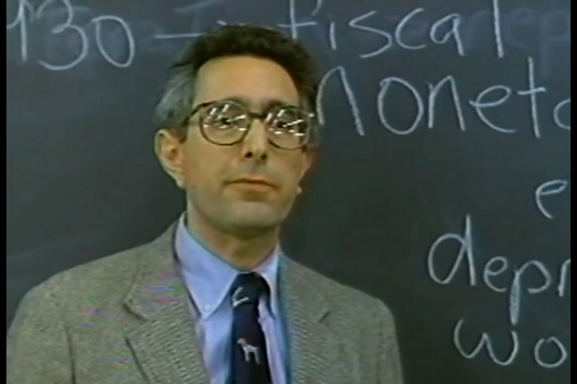
Effectively Promoting Participation and Interaction
Notes:
A. Effectively Promoting Participation and Interaction
Activity: Ask participants: What is “Ben Stein Syndrome?” Someone will likely recall the famous teacher from the movie Ferris Buehler’s Day Off. Anyone? Anyone? Click to play video.
Have each group spend five to ten minutes discussing the BEST teacher they have ever had and the WORST teacher they have ever had. Have groups compare to see if there are any common traits in their BEST and WORST.
Use two easels/easel pads and volunteers to document the WORST (on the first chart) and the BEST (on the second chart). Retitle the easels/easel pads at the end of the activity as LECTURER on the WORST and INSTRUCTOR on the BEST.
During the activity, underline and emphasize the following three characteristics of a lecturer:
Talks AT the audience
Does not consider the audience’s goals or expectations
Does not interact with audience members
Lecturer:
What are some of the characteristics of a lecturer?
__________________________________________________________________
__________________________________________________________________
__________________________________________________________________
Next slide discusses instructor characteristics

Slide 6
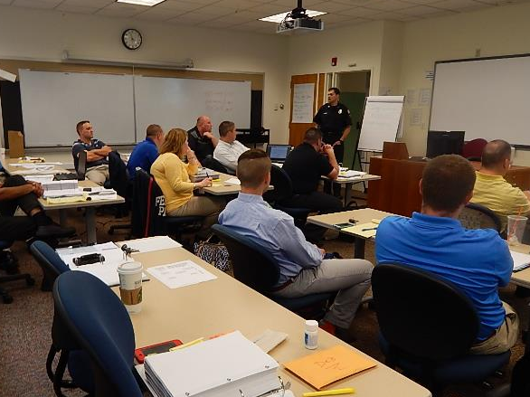
Communication Skills of a Good Instructor
Attentive
Observant
Listener
Questioning
Notes:
B. Four Communication Skills of a Good Instructor
Activity: During the activity, underline the four characteristics to be addressed during this session:
Attentive
Observant
Listener
Questioning
If the participants do not list these four qualities, you will need to work them onto easel/easel pad titled BEST.
Ask participants if they have additional examples of an instructor being attentive.
Reveal bullets on slide.
Demonstrate some of these attentive skills in the classroom.
Stress the following: When walking into a presentation you must have a good grasp of the audience’s skill or knowledge level. Begin by stating the task/problem, briefly outline what will be demonstrated and applied, and follow-up by asking questions to activate participants’ prior knowledge and skills as a foundation for new skills.
_________________________________________________________________________________
_________________________________________________________________________________

Slide 7
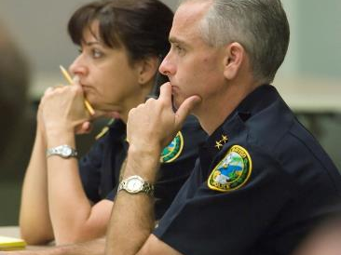
Attentive
Physical presentation
Encourages participation
Facing participants
Maintaining appropriate eye contact
Moving toward participants when appropriate
Avoiding distracting behavior
Notes:
Attentive
Physical presentation that shows the instructor is paying attention
Encourages participation
Facing participants
Maintaining appropriate eye contact
Moving toward participants when appropriate
Avoiding distracting behavior
__________________________________________________________________________
__________________________________________________________________________
_______________________________________________________________________________
_______________________________________________________________________________
_______________________________________________________________________________
_______________________________________________________________________________
_______________________________________________________________________________
_______________________________________________________________________________
_______________________________________________________________________________
_______________________________________________________________________________

Slide 8
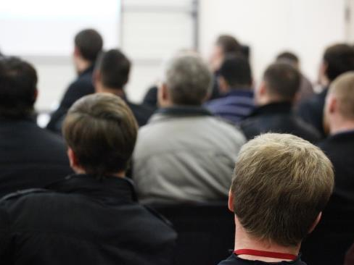
Observant
Participants’ face, body position, and movements
Infers attitudes of participants
Takes appropriate action
Notes:
Observant
Face, body position, and body movements of the participants
Infers attitudes of the participants based on observations of the above
Takes appropriate action based upon inferences
__________________________________________________________________________
__________________________________________________________________________
_______________________________________________________________________________
_______________________________________________________________________________
_______________________________________________________________________________
_______________________________________________________________________________
_______________________________________________________________________________
_______________________________________________________________________________
_______________________________________________________________________________
_______________________________________________________________________________
__________________________________________________________________________

Slide 9

Listener
Listen
Paraphrase
Be cognizant and sensitive
Notes:
Listener
Listen to what is said
Paraphrase what was said to demonstrate understanding
Be cognizant and sensitive to possible internal and external distractions affecting the participants
__________________________________________________________________________
__________________________________________________________________________
_______________________________________________________________________________
_______________________________________________________________________________
_______________________________________________________________________________
_______________________________________________________________________________
_______________________________________________________________________________
_______________________________________________________________________________
_______________________________________________________________________________
_______________________________________________________________________________

Slide 10

Questioning
Helps determine what is already known
Invites participants
Provides feedback
Enables audience to assess learning
Gauge audience’s skill or knowledge level
Notes:
Questioning
Helps determine what the participants already know
Invites participation
Provides you, the instructor, with feedback
Enables audience to assess their own learning and fill in the gaps
When walking into a presentation without a good grasp of the audience’s skill or knowledge level, asking questions up front can gauge this very easily
__________________________________________________________________________
__________________________________________________________________________
_______________________________________________________________________________
_______________________________________________________________________________
_______________________________________________________________________________
_______________________________________________________________________________
_______________________________________________________________________________
_______________________________________________________________________________
_______________________________________________________________________________
_______________________________________________________________________________

Slide 11

Questioning Methods
Notes:
C. Questioning Methods
Prepare to discuss the questioning methods.
Overhead/undirected
Pre-directed
Overhead/directed
__________________________________________________________________________
__________________________________________________________________________
_______________________________________________________________________________
_______________________________________________________________________________
_______________________________________________________________________________
_______________________________________________________________________________
_______________________________________________________________________________
_______________________________________________________________________________
_______________________________________________________________________________
_______________________________________________________________________________

Slide 12

Overhead/Undirected Question
Notes:
Overhead/Undirected Questions
Discussion: Ask participants this exact question: “What would be an example of an overhead/undirected question?”
Provide the answer, after obtaining responses to the above question.
Overhead/undirected question is one where the question is thrown out to the
­ Entire Class .
Advantages:
Engages the entire class
Allows the instructor to identify the “apple polisher” in the class
Disadvantages
Allows people to refrain from participating
Continued use allows the over-eager participants to dominate the class
__________________________________________________________________________
__________________________________________________________________________
_______________________________________________________________________________
_______________________________________________________________________________
_______________________________________________________________________________

Slide 13

Pre-Directed Question
Notes:
Pre-Directed Questions
Discussion: Ask a particular participant, “Name, can you give me an example of a pre-directed question?”
Make sure you say the participant’s name before posing the question.
Let the class know…
A pre-directed question is one in which a participant is Selected Before the question is posed.
Emphasize that instructors should pause after saying the participant’s name when using this technique.
Advantages:
Can be used to engage hesitant participants
Can be used to gain the attention of a disruptive or distracted participant
Disadvantages
Enhance participation by only one participant
Once the question is directed, everyone else can stop paying attention
__________________________________________________________________________
__________________________________________________________________________

Slide 14
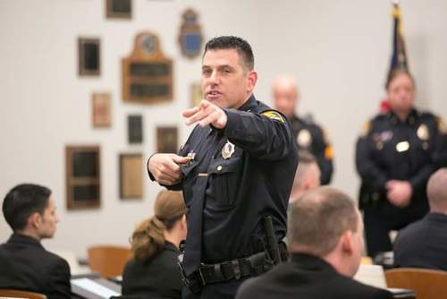
Overhead/Directed Question
Notes:
Overhead/Directed Questions
Discussion: Ask the class, “What would be an example of an overhead/directed question, Name?” Say the participant’s name at the end of the question.
Let class know…
An overhead/directed question, the presenter asks an overhead question,
then pauses and directs it to a particular participant.
Advantage:
Combines the advantages of the other types of questions
Disadvantages
During the pause between posing the question and selecting the respondent, it is common for the over-eager participants to chime in and answer the question
__________________________________________________________________________
__________________________________________________________________________
_______________________________________________________________________________
_______________________________________________________________________________

Slide 15

Handling Participants Answers
Notes:
D. Handling Participants’ Answers
Discussion: Use hypotheticals to demonstrate these techniques.
When a participant gives a correct answer:
Commend participant
React with positive reinforcement
Don’t give bland acknowledgement
Don’t fail to give any reaction at all
When a participant gives an incorrect answer:
Convey answer is incorrect
Do not react with frustration or anger
Do not embarrass the participant
Acknowledge partially correct answers
When participants do not respond, stress increases, participation drops, and learning is minimized. You can use the following methods to deal with the situation:
Provide the answer yourself
Redirect the question to another participant
Defer the question
__________________________________________________________________________
__________________________________________________________________________
_______________________________________________________________________________

Slide 16

Handling Participants’ Questions
Notes:
E. Handling Participants’ Questions
Remind the class, participants sometimes ask questions instructors cannot answer.
Participants sometimes ask questions instructors cannot answer. You can use the following techniques to deal with the situation:
Admit you do not know the answer, but offer to research it
Redirect the question to another participant
Defer the question
__________________________________________________________________________
__________________________________________________________________________
_______________________________________________________________________________
_______________________________________________________________________________
_______________________________________________________________________________
_______________________________________________________________________________
_______________________________________________________________________________
_______________________________________________________________________________
_______________________________________________________________________________

Slide 17
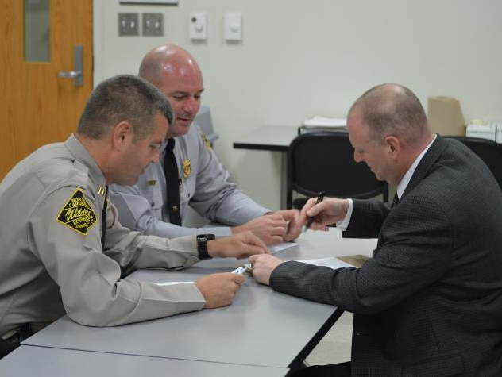
Conclusion
Notes:
F. Conclusion
During the conclusion, ask participants to think about these types of questioning techniques. We will learn ways to handle problem situations in the next Session. Can these questioning techniques be used to effectively respond to problems?
Elicit the following points from the class regarding what would make an effective instructor.
Effective instructors:
Are attentive to their participants
Are observant of their participants
Listen to their participants
Help participants learn from one another
__________________________________________________________________________
__________________________________________________________________________
_______________________________________________________________________________
_______________________________________________________________________________
_______________________________________________________________________________
_______________________________________________________________________________
_______________________________________________________________________________

Slide 18

Questions and/or Concerns
Notes:
G. QuestionS AND/OR CONCERNS
Solicit questions and comments from participants before moving to the next Session.
__________________________________________________________________________
__________________________________________________________________________
_______________________________________________________________________________
_______________________________________________________________________________
_______________________________________________________________________________
_______________________________________________________________________________
_______________________________________________________________________________
_______________________________________________________________________________
_______________________________________________________________________________
_______________________________________________________________________________
__________________________________________________________________________
__________________________________________________________________________

